Slide 1
Welcome to the
5th Tennis Sussex Awards 2014

Slide 2
Tennis Sussex Awards 2014
Celebrating achievements all over
Sussex in 2014
All ages
All abilities
Clubs, Parks, Schools, Players, Teams
Coaches, Referees, Volunteers …….

Slide 3
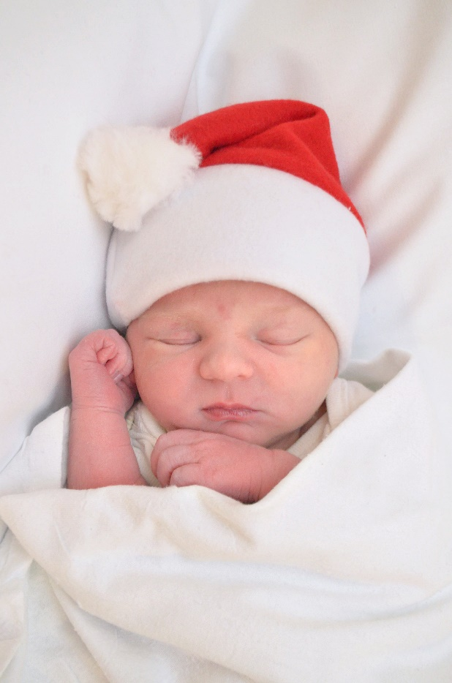
December 2013
Baby Ben Bartlett born

Slide 4
January & February 2014
Virgin Active Open - 150 players
AGM hosted by Singing Hills, Golf Club
  Tennis Sussex Summer League trophies awarded
Tennis Sussex moves into the AMEX Community Stadium saying goodbye to 12 years at Tongdean Lane
LTA releases the new organisation structure
West Worthing Tennis & Squash Club host Basic Referee Course
  20 organisers receive competition training
Pav & Ave Junior Open 2014 -174 players

Slide 5
March 2014
18U Boys Aegon County Cup-played in Birmingham-winning Group 2
18U Girls Aegon County Cup-played in Bath- Girls lost in Group 1
Andy Trott working with Albion in the Community-delivered training to 25 football coaches to deliver tennis in schools.
Club Forums-West Worthing Tennis & Squash Club and Virgin Active Brighton host forums -25 Coaches and 40 Clubs are informed about the LTA restructure

Slide 6
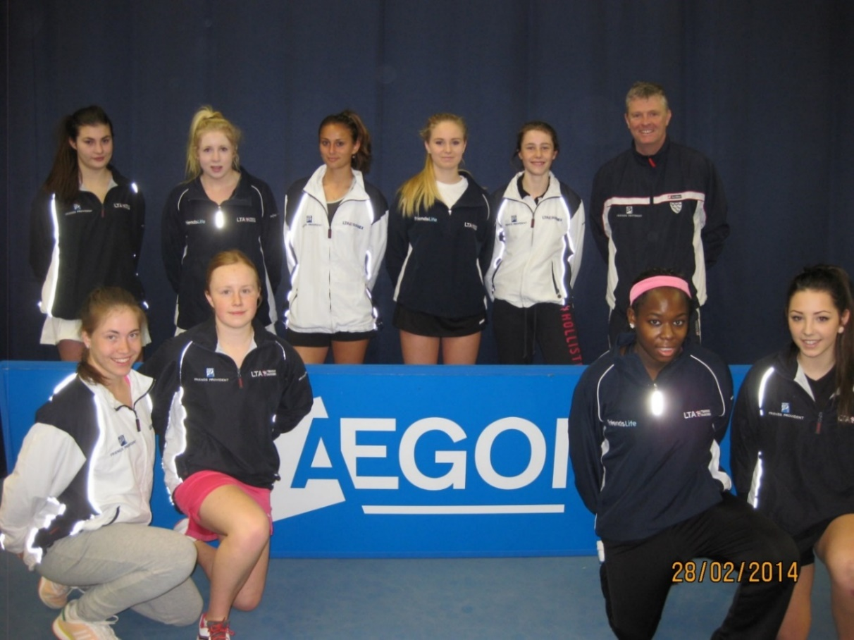
Aegon 18U County Cup-Girls Group 1
Captain; Matt Edwards; Assistant Hollie Gosden
Team; Tsvetomira Arsenova, Lauren Bishop, Mariella Blackwell, Anna Kilsby, Lisa Phillips, Naomi Jackson, Holly Thompson, Elise Van Heuvelen, Anastasia Reimchen.

Slide 7
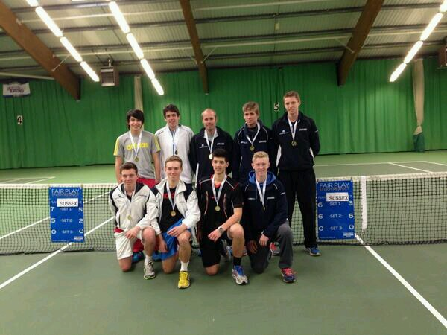
Aegon 18U County Cup-Group 2B
Div1 in 2015
Coach Captain; Andrew Cook, Assistant; Keelan Oakley
Team: Logan Burgess Hayes, Jack Burkill, Julian Cash, Ben Horton, Daniel Little, Peter Molloy, William Matthews & Sam Rice

Slide 8
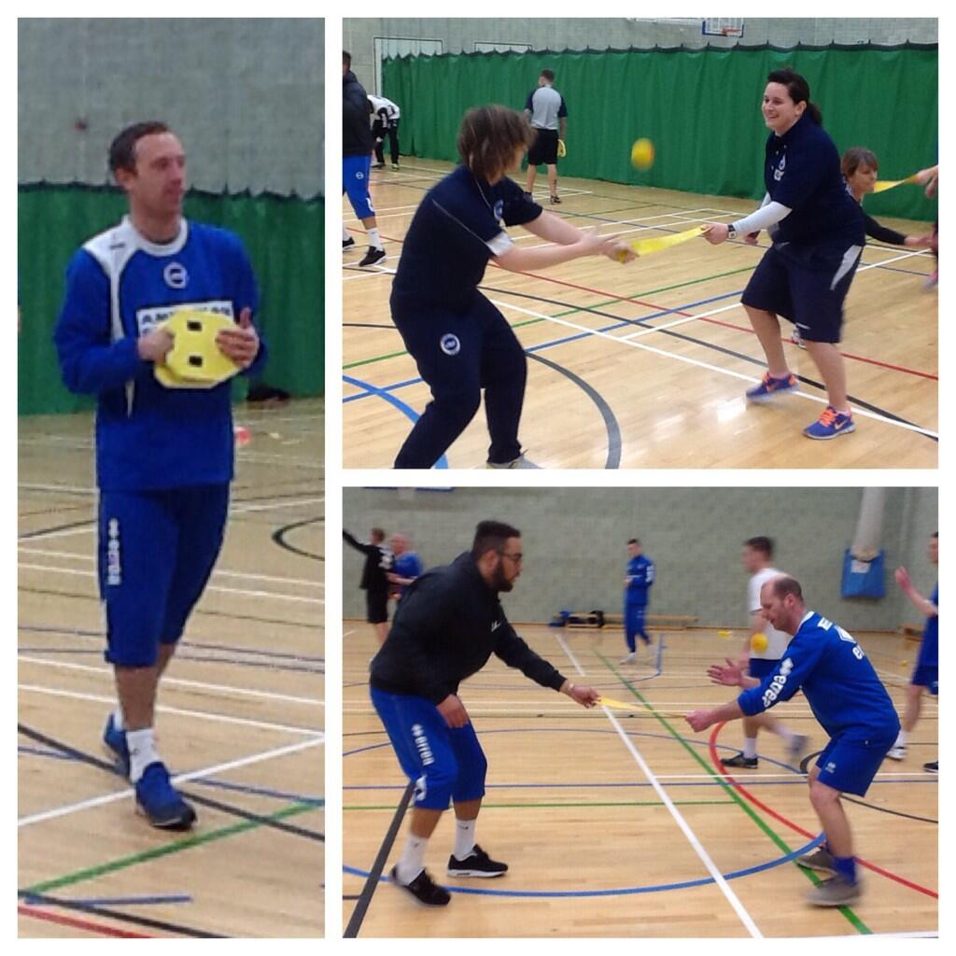
March/April- Andy starts working with Albion in the Community
25 Football coaches now delivering tennis in 10 schools across Sussex

Slide 9
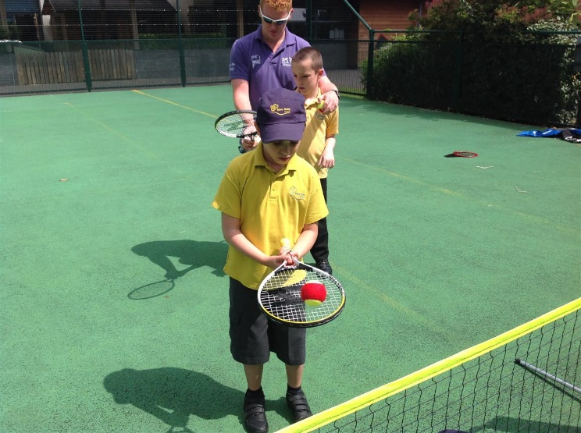
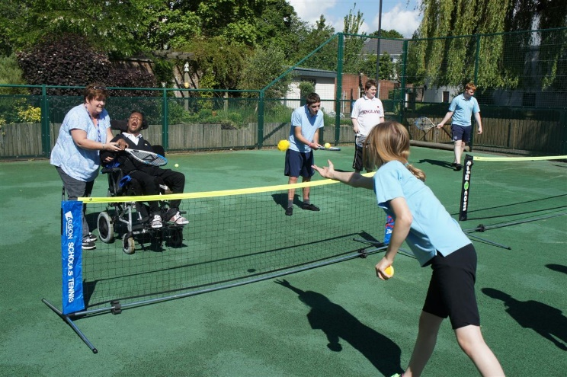
Albion in the Community

Slide 10
April 2014
West Worthing Tennis & Squash Club host a Basic Referee course –
  18 orgainsers receive competition training
Road to Wimbledon - Stage 1 starts
Tennis Crawley Easter Junior Open - 212 players
Road 2 Eastbourne starts
National Inter-Club Championships start - Mens 45 Crawley LTC entered
National Inter-County Championships start
Sussex Inter-Club Senior Leagues start

Slide 11
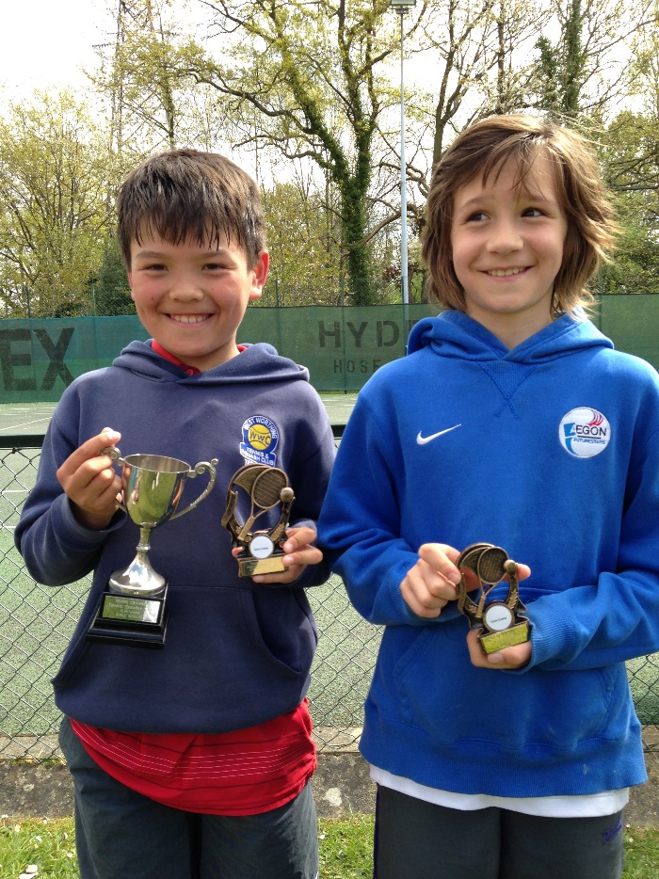
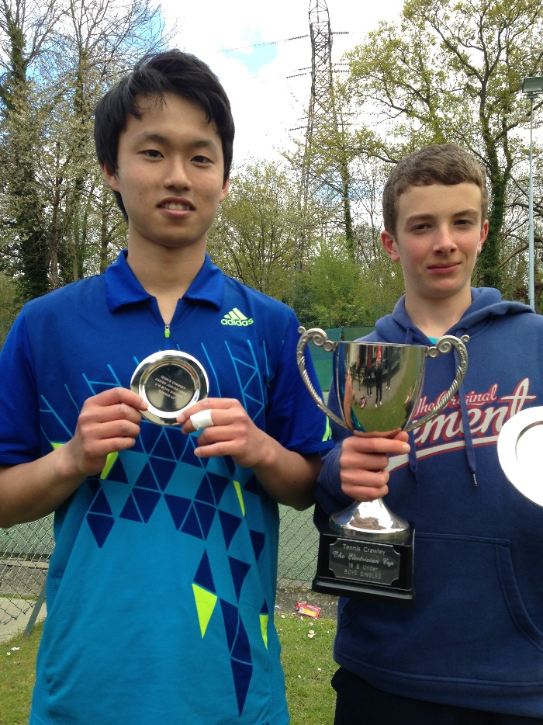
Tennis Crawley Easter Junior Open

Slide 12
Aegon Team Tennis-Results
Age & Gender | Winning Place to Play (Full name) | Division | Age & Gender | Winning Place to Play (Full name) | Division
8&U Mixed | Pavillion & Avenue Lawn Tennis Club A | Div 1 Group A | 12&U Girls | Pavillion & Avenue Lawn Tennis Club B | Division 1
8&U Mixed | Pavillion & Avenue Lawn Tennis Club B | Div 1 Group B | 12&U Girls | Storrington Lawn Tennis Club A | Division 2
8&U Mixed | Chichester Lawn Tennis & Squash Club | Div 1 Group C | 14&U Boys | Pavillion & Avenue TC | Division 1
8&U Mixed | David Lloyd Eastbourne | Div 1 Group D | 14&U Boys | Preston Lawn Tennis Club | Division 2
8&U Mixed | Horsham Lawn Tennis Club A | Div 1 Group E | 14&U Boys | The Holbrook Club | Division 3
9&U Mixed | Virgin Active Brighton | Div 1 Group A | 14&U Boys | Crawley Lawn Tennis Club | Division 4
9&U Mixed | Le Tennis | Div 1 Group B | 14&U Girls | Pavillion & Avenue Lawn Tennis Club | Division 1
9&U Mixed | Chichester | Div 1 Group C | 16&U Boys | Preston Lawn Tennis & Croquet Club | Division 1
9&U Mixed | East Hoathly | Div 1 Group D | 16&U Boys | Seaford & Blatchington Lawn Tennis Club | Division 2
10&U Mixed | West Worthing Club | Div 1 Group A | 16&U Boys | Crawley Lawn Tennis Club | Division 3
10&U Mixed | Southdown Sports Club | Div 1 Group B | 16&U Girls | Weald Lawn Tennis & Squash Rackets Club | Division 1
10&U Mixed | Billingshurst Tennis Club | Div 1 Group C | 18&U Boys | Angmering-On-Sea Lawn Tennis Club | Division 1
10&U Mixed | Comptons Tennis Club | Div 1 Group D | 18&U Boys | Seaford & Blatchington Lawn Tennis Club | Division 2
12&U Boys | Pavillion & Avenue Lawn Tennis Club | Div 1 | Open Men | Southdown Sports Club | Division 1
12&U Boys | Weald Lawn Tennis & Squash Rackets Club | Div 2 | Open Ladies | Storrington Lawn Tennis Club | Division 1
12&U Boys | Preston Lawn Tennis & Croquet Club | Div 3
12&U Boys | Horsham Lawn Tennis Club A | Div 4

Slide 13
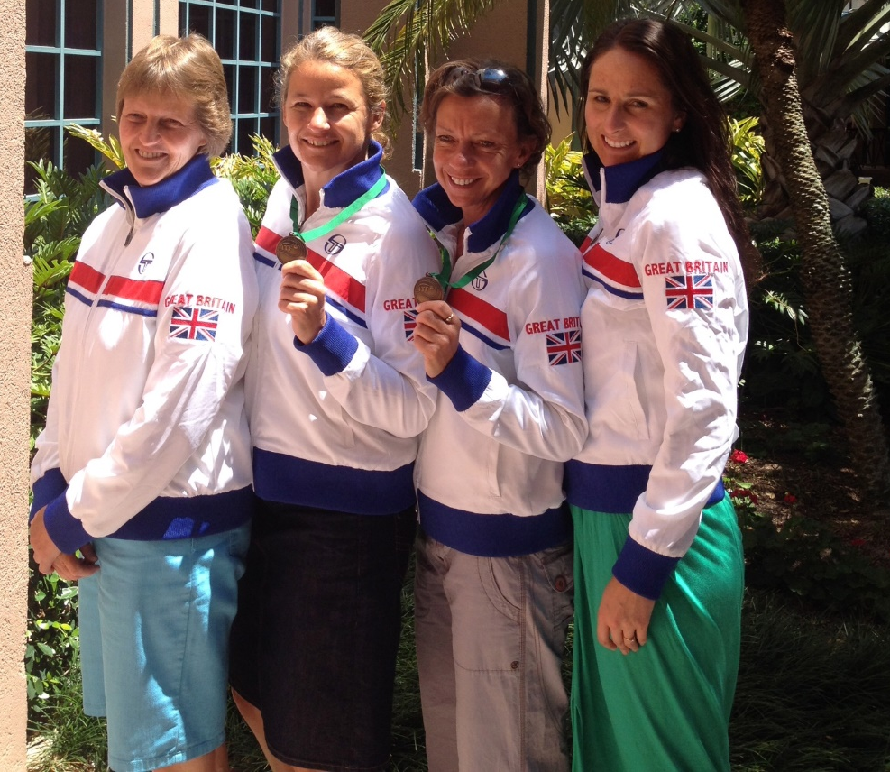
APRIL - 2014 ITF Seniors World Team Championships in Florida
Sussex participants;
  Jheni Osman (35s) Jenny Hughes (50s)
  Clare Wood and Julie Salmon (45s) – won bronze

Slide 14
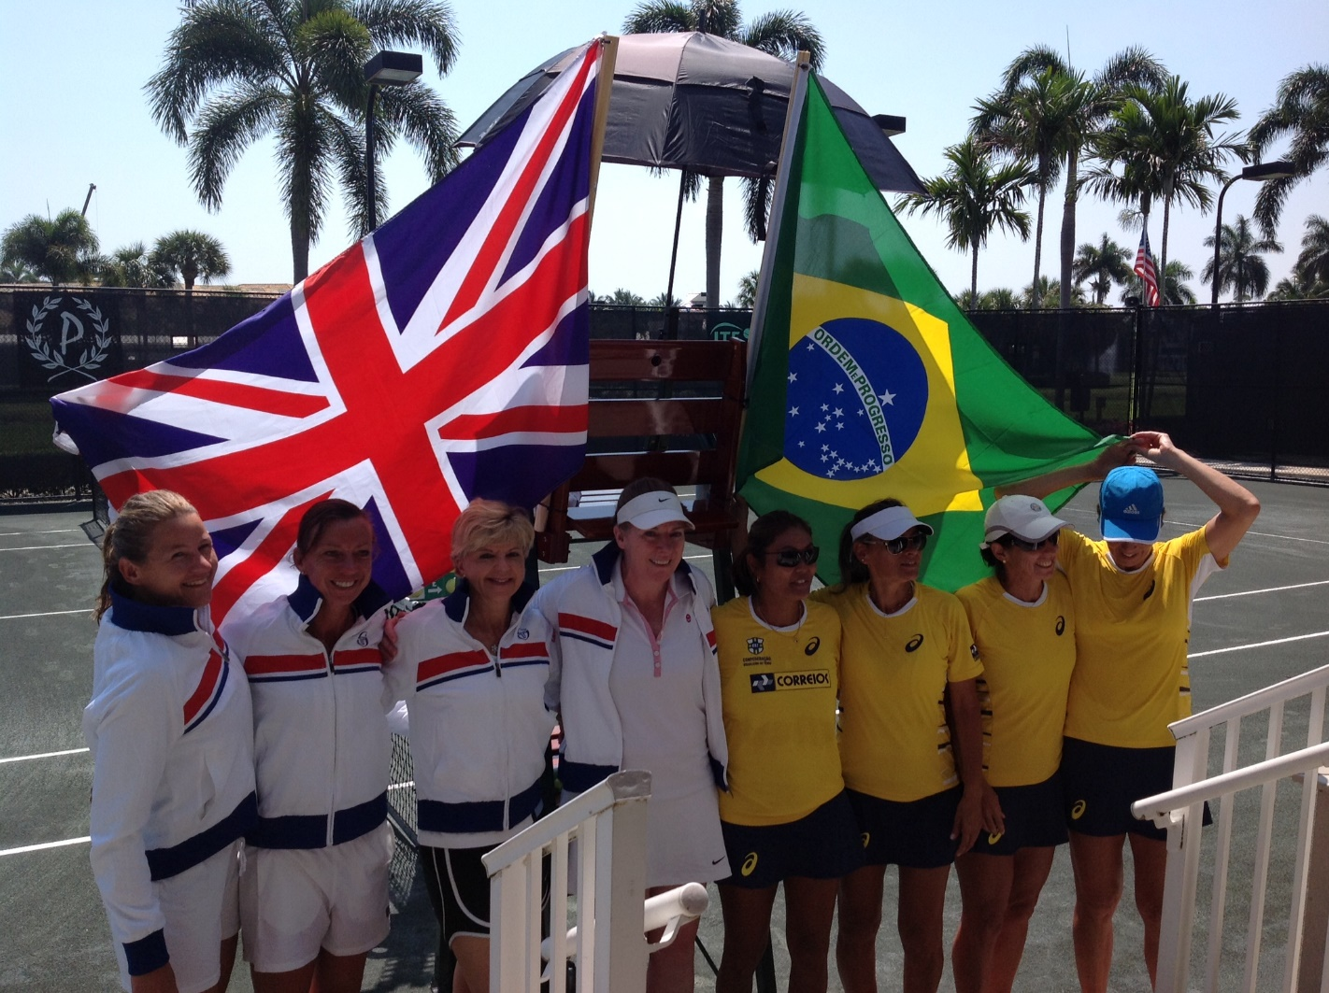
Clare Wood and Julie Salmon - Over 45s Margaret Court Cup. Win group beating South Africa, Mexico and Argentina. Lost to France in the semi finals, beat Brazil 2-0 in the play off for 3rd/ 4th place.

Slide 15
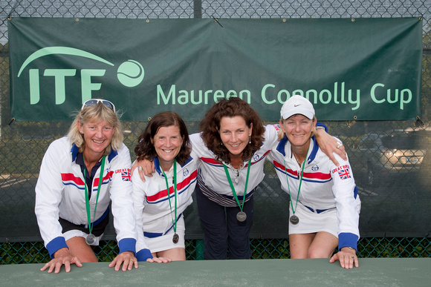
APRIL - 2014 ITF Seniors World Team Championships in Florida
Sussex participants;
  Anne Clark (55s) – won silver in Maureen Connolly Cup

Slide 16
May 2014
Aegon 14U County Cup
Girls won qualifying event hosted by NTC - Surrey
Girls finish 3rd in the National Finals hosted in Nottingham
Boys won qualifying event hosted by Sutton - Surrey
Boys finish 8th in the National Finals hosted in Nottingham
GBTW-clubs run open days offering Free Tennis sessions
Aegon Team Tennis continues
Aegon 10U County Cup
Girls 5th in qualifying event hosted by Pavilion & Avenue
Boys 2nd in qualifying event hosted by Bromley Kent
Collins Honda Seaford Open - 91 players

Slide 17
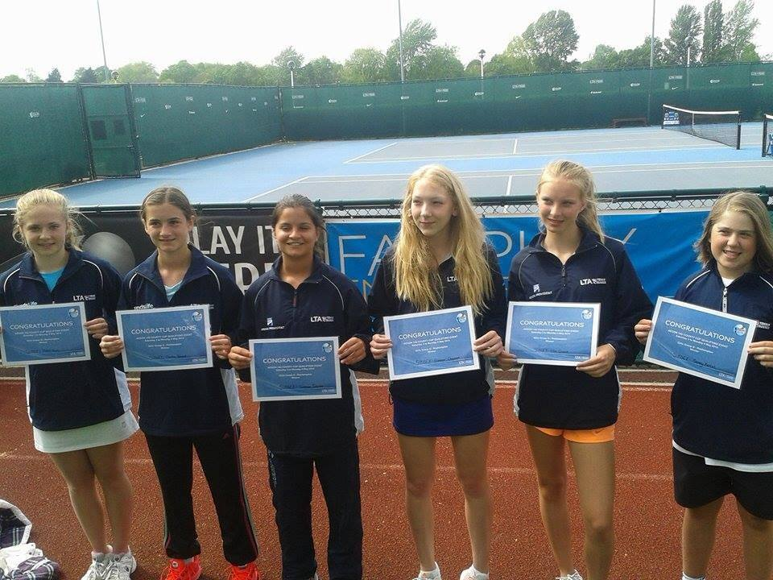
Aegon 14U County Cup Girls
Team Captain; Tim Cottingham, Assistant; Kyria Dunford
Team Players; Eleanor Chapman, Ellie Dasent, Gemma Poland, Hollie Irwin, Sonay Kartal, Saffron Dowse

Slide 18
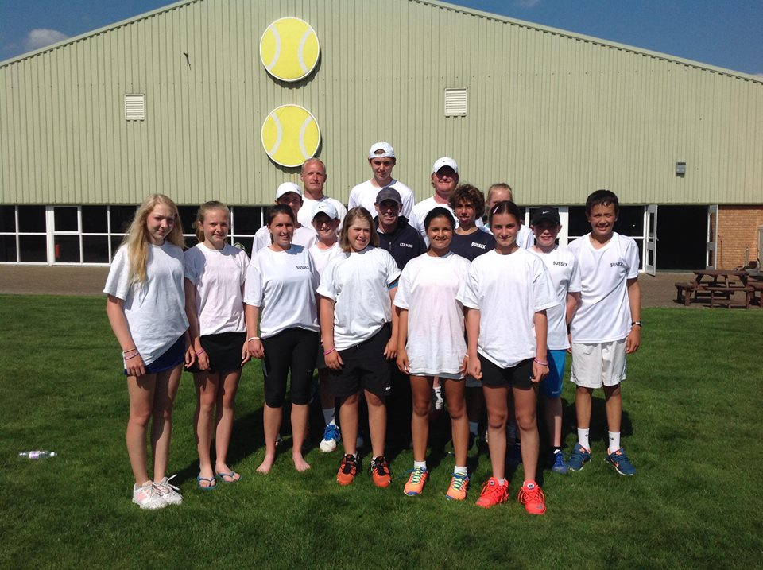
Aegon 14U County Cup-Both Teams play in Nottingham
Boys Team - 8th Nationally
Team Captain; Brett MacDonald, Assistant Joshua Wilson
Team Players Boys; Kai Maxted, Andre Bennett, Ethan Parker, Alex Targett, Gregor Shaw, Henry Hughes

Slide 19
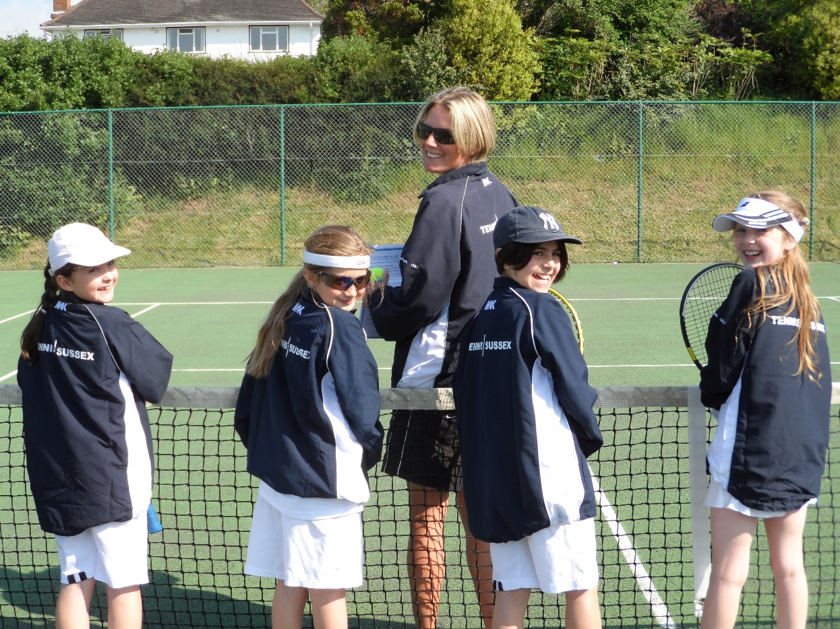
AEGON 10U County Cup 2014
Girls Team Tennis Coach Captain; Julie Hobbs
Team; Madison Broadbent, Cara McCully, Evelyn Thoms,
Olivia Venditto

Slide 20
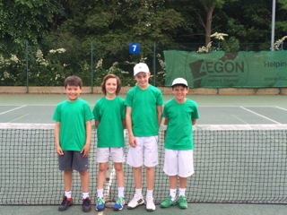
AEGON 10U County Cup 2014
Boys Team Tennis Coach Captain; Chris Colvin
Team; Lui Maxted, Lemuel Cassidy, Callum Harvey, Thomas Pollard, Ben Goodwin

Slide 21
June 2014
Aegon International Play Tennis Zone - 1,000 school children visit the tennis for free
Road to Eastbourne - 100 schools takepart across Sussex
GBTW – 35 Sussex venues took part offering free tennis sessions
Takepart in Preston Park - 300 people played tennis for free
12U Aegon County Cup
Schools Championship - 21 schools took part, organised by Jane Nash
Hollie Gosden starts her new role with LTA – South East Team - Regional Tennis Competition Coordinator
Martin Reeves - leaves LTA- we welcome him back as a coach in Sussex

Slide 22
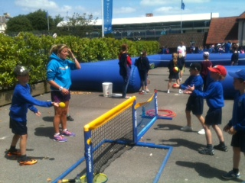
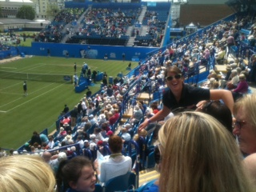
Aegon International
Play Tennis Zone-School Photo

Slide 23
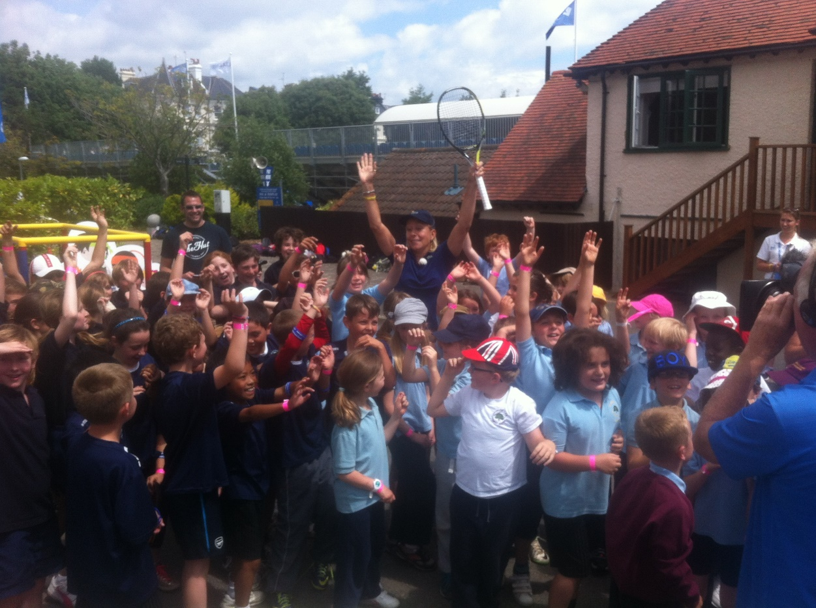
Martina Navratilova
Visits Play Tennis Zone

Slide 24
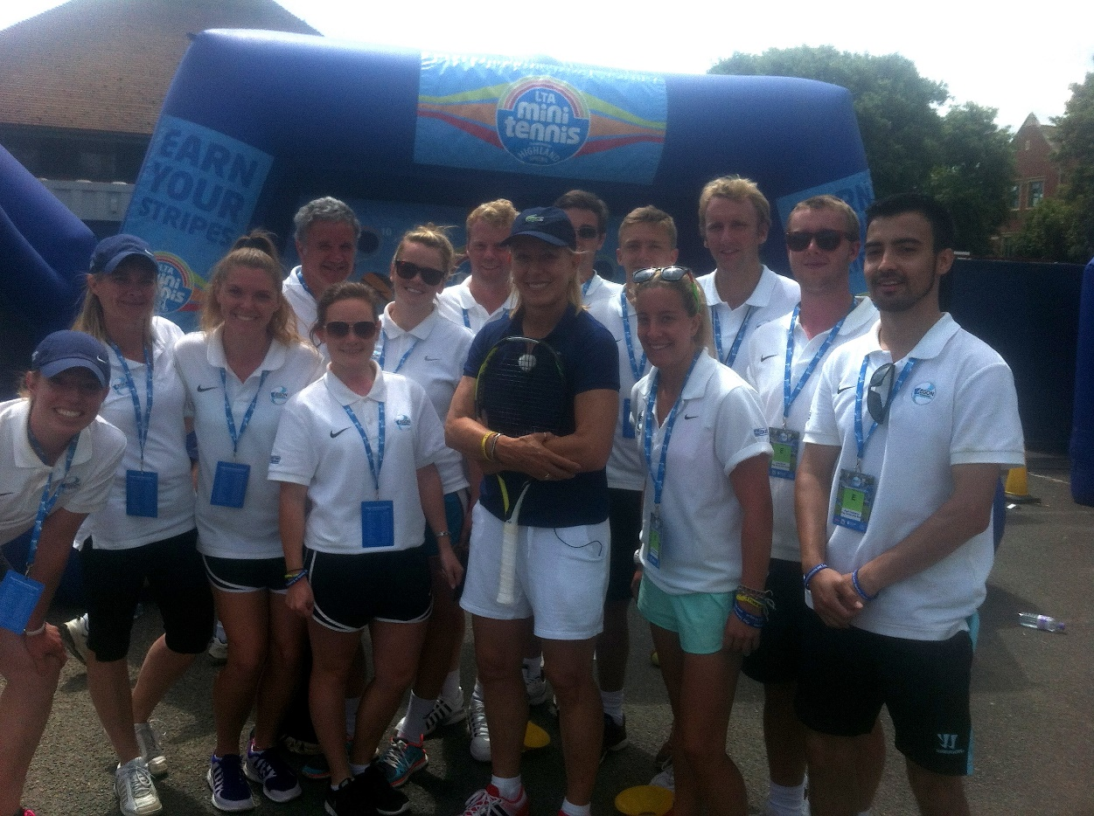
Staff at the Play Tennis Zone
Aegon International

Slide 25
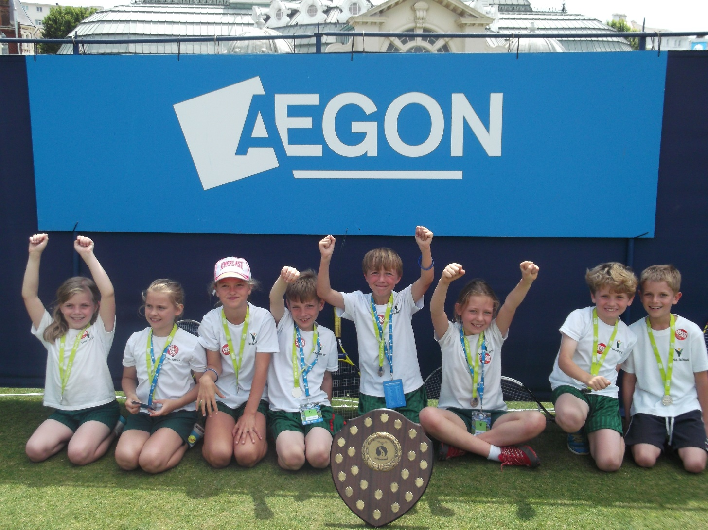
Road to Eastbourne - 100 schools took part across Sussex
The winner - Vale School

Slide 26
Sussex Schools Tennis Championships
March to June- Organiser-Jane Nash
Hosted by Bede’s School
Over 800 young Sussex tennis players competed for their schools
Teams made up of four players competing in the Boys or Girls events, both singles and doubles
Results
7th March - U7 & U8 Events. Winners Boys event - Bede’s beat Lancing. Girls’ Event - Bede’s beat Moira House
April 24th - U16 - Winners Boys event - Bede's beat Cardinal Newman. Girls’ event - Burgess Hill beat Eastbourne College
1st May U18 - Boys event Bede’s A beat Bede’s B. Girls’ event - Bede’s beat Moira House

Slide 27
Sussex Schools Tennis Championships
March to June- Organiser-Jane Nash
Hosted by Bede’s School
Results continued
6th May - U9 – Boys event-Bede's beat Lancing Prep, Girls event - Moira House beat Bede’s
9th May - U11 – Boys event - Bede's beat Great Walstead, Girls event - Moira House beat Bede’s
23rd May - U12/13 event - Boys event - St Andrews beat Great Walstead. Girls event - Bede’s beat Millais
5th June - U10 – Boys event - Brighton College beat their B team. Girls event- Moira House beat Bede’.
12th June - U14 Event – Boys event - Bede’s beat Cardinal Newman, Girls event - Millais beat Brighton College
19th June - U15 Event, Bede’s winning the Boys. Brighton College the Girls and the Under 15 title

Slide 28
July 2014
Crowborough Open - 100 players played
9U Aegon Mixed County Cup
Hollie Gosden and Luke Milligan tie the knot
Senior Inter County Cup ladies – stay in Div 3
Senior Inter County Cup men – win Div 5
12U girls Aegon County Cup -win National title in Bolton
Wimbledon - Julian Cash receives Wild card to Junior Wimbledon

Slide 29
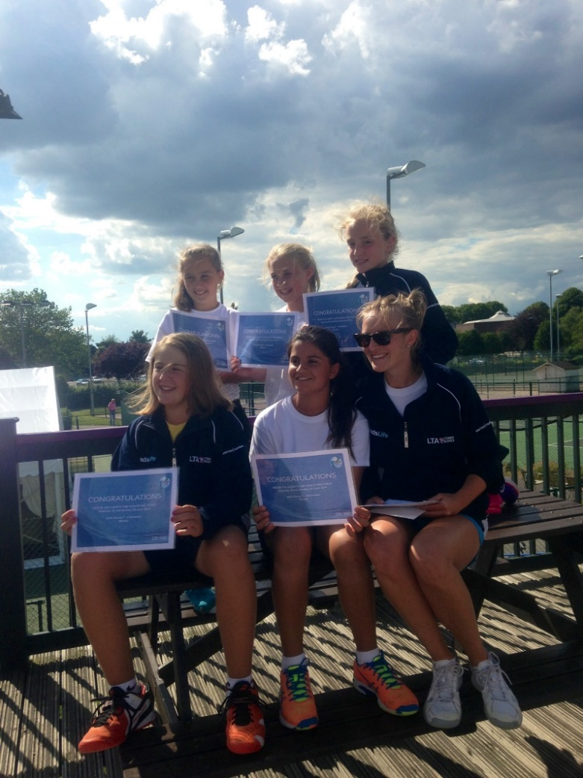
12U Girls win Aegon County Cup National title
Team Captain; Lydia Hammond
Team Players; Sonay Kartal, Issy Swann, Saffron Dowse, Tiana Fox, Ella Goldin

Slide 30
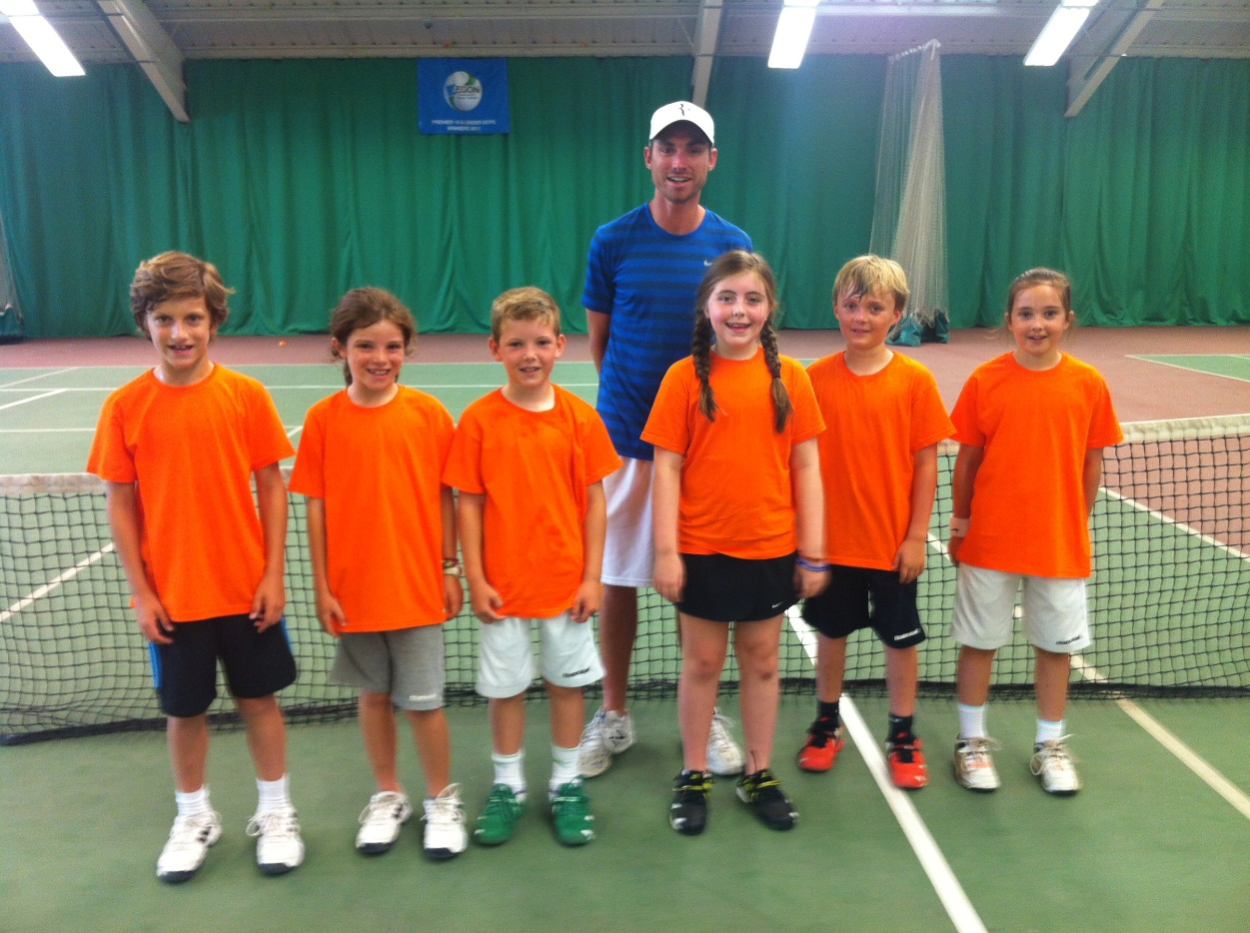
Aegon 9U Mixed County Cup
Coach Captain; Jack Palmer
Team; Grace Tuson, Evelyn Thoms, Imogen Mcnaughton-Ely, Darcy Pycroft, Charlie Homes, Finlay Edwards
A fantastic day for all with the team really fighting hard! Happily accepting 3rd place for the day

Slide 31
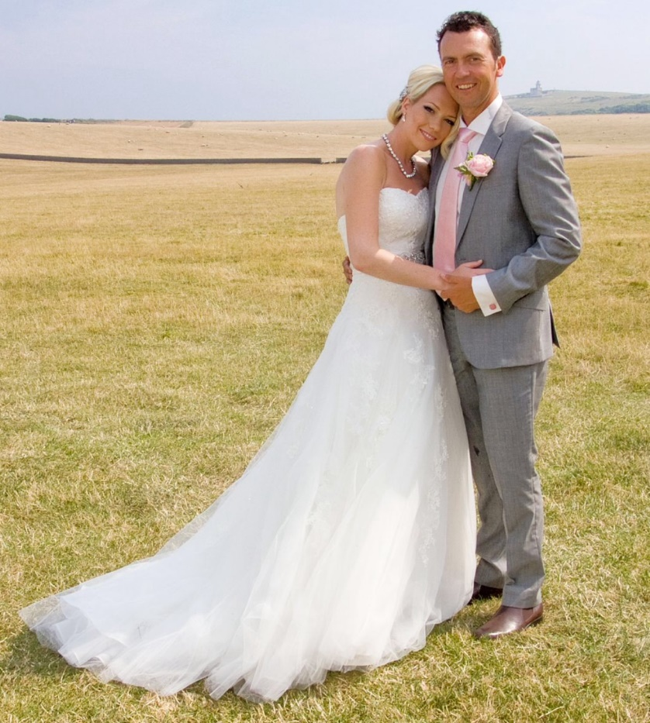
Mr & Mrs L Milligan

Slide 32
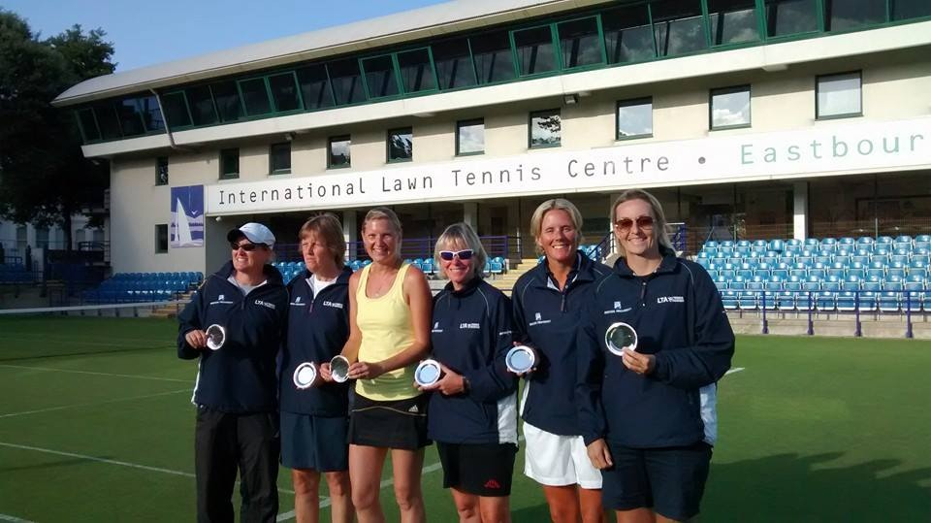
Over 35s Ladies Inter County Cup
Win National title 4th Year running
Captain; Julie Hanger
Team; Kate Bloomfield, Julie Hanger, Julie Hobbs, Jenny Hughes, Helen Mitchell, Steph Trill

Slide 33
August 2014
Weald Open in association with Nick Rivett Sports – Hove - 198 players
European Beach Tennis - 22 Countries played in Brighton
Senior Tennis International event - Devonshire Park
West Worthing Club - Junior Open - 143 players
Nike Junior Nationals Tennis Championships – Main Draw- Sam Rice, Lauren Bishop, Holly Thompson, Jack Burkill, Kai Maxted, Gemma Poland, Sonay Kartal, Safron Dowse
Pavilion & Avenue open their new clay courts
Devonshire Park Open - 259 players
Junior County Closed - 177 players
Road to Wimbledon Finals

Slide 34
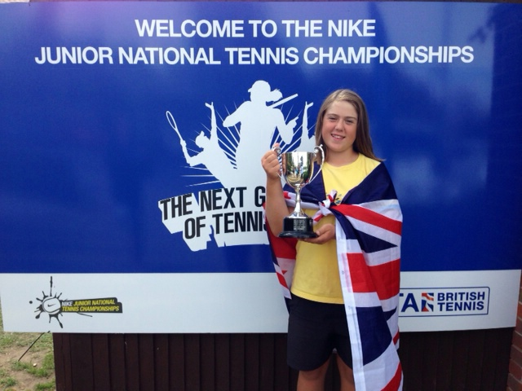
12U Champion at the Nike Junior Nationals Championships-
Sonay Kartal

Slide 35
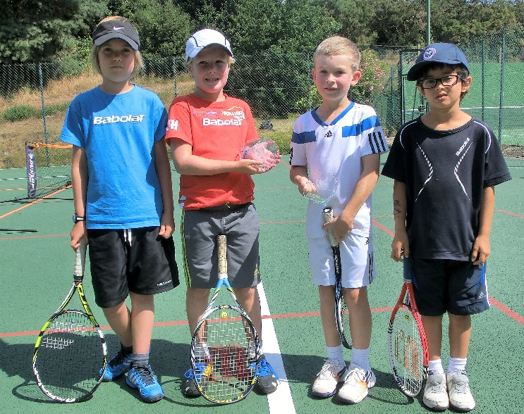
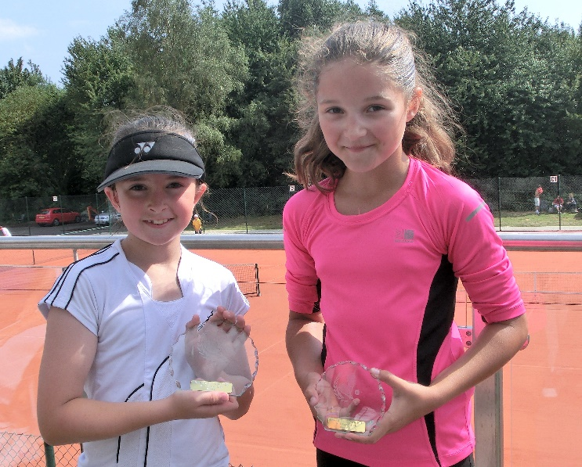
Weald Open in association with Nick Rivett Sports – Hove

Slide 36
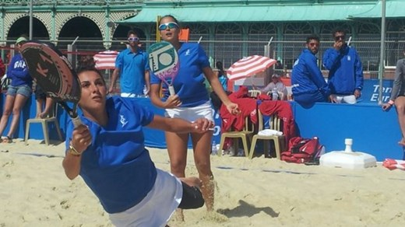
Beach Tennis-European-Brighton-Yellow wave- 22 Countries compete

Slide 37
Road to Wimbledon
Club | Boys Winner | Girls Winner
Angmering | Tom Hesling
Chichester | Callum McKitterick
Crawley | William Irving | Katie Parkinson
Horsham | Joseph Michael Murphy
Hampden Park | Aaron Brown
Harbour Way | Oliver De Candole
Meads | Max Rust
Midhurst | Toby Althaus
Pav & Ave | Toby Bloomfield | Tiana Fox
Preston | Adam Carter-Johnson | Katy Graydon
Seaford | Brodie Sallows

Slide 38
Road to Wimbledon
Club | Boys Winner | Girls Winner
Sussex County | Callum Sheldrake
VA Brighton | Oliver Dawwas | Roberta Vine
Weald | Joel Davis | Annabelle Bower
West Worthing | Thomas Hearn | Caitlin O’Brien
Withdean | George Taylor
County Finals winners-All 4 players went on to compete at the National Stage at Wimbledon.
Event | Winner | Runner-Up
Boys | Alex Fox | Adam Carter-Johnson
Girls | Tiana Fox | Sophie Kitson

Slide 39
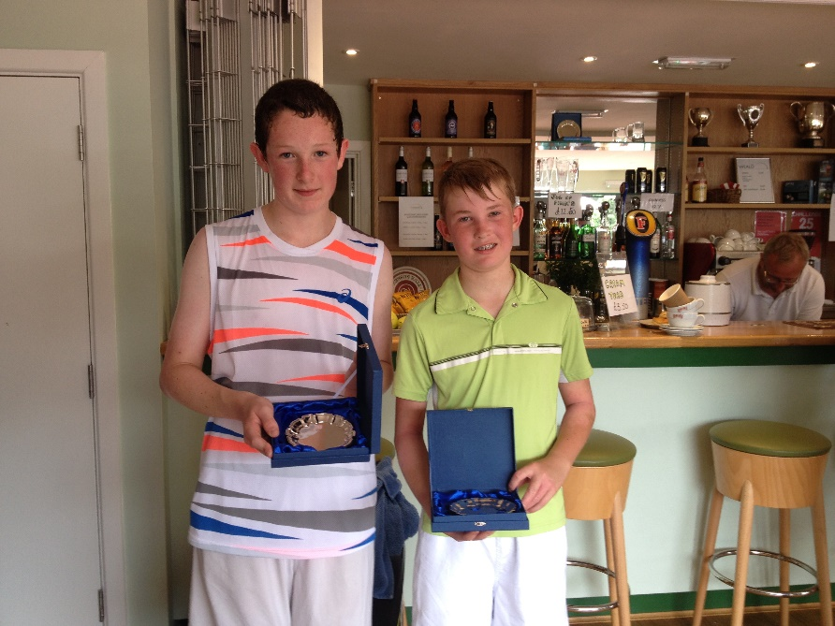
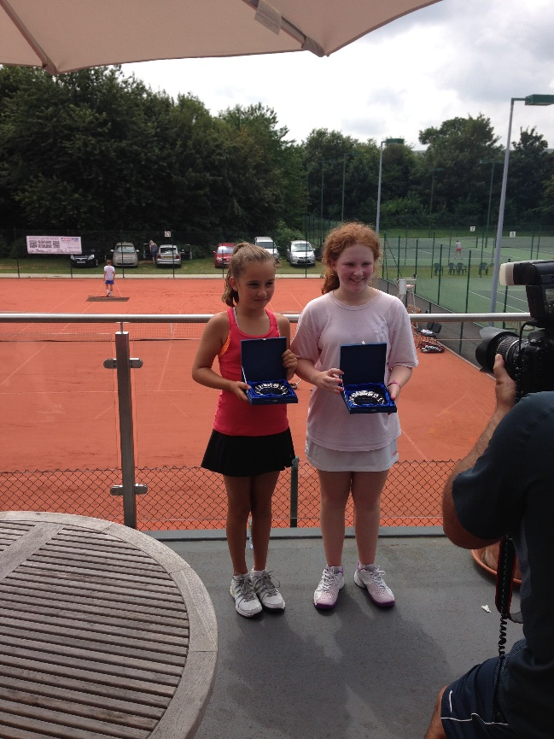
Road to Wimbledon –
Sussex Finalists who went onto play the Regional event

Slide 40
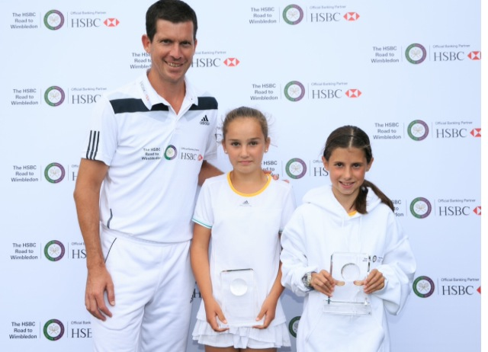
Regional Finalist
Doubles event - Tiana Fox
After 3 matches Alex Fox and Tiana Fox qualified for the main draw
Tiana Fox went on to be semi-finalist
Doubles; Tiana Fox partnered Millie-Mae Matthews (Nottinghamshire) and finished as runner-up
Tiana (centre) with Tim Henman and Millie-Mae
National Stage (Regional)
Kai Maxted was the only Sussex player to compete in this stage
Kai won his qualifying box at Wimbledon to qualify for the main draw

Slide 41
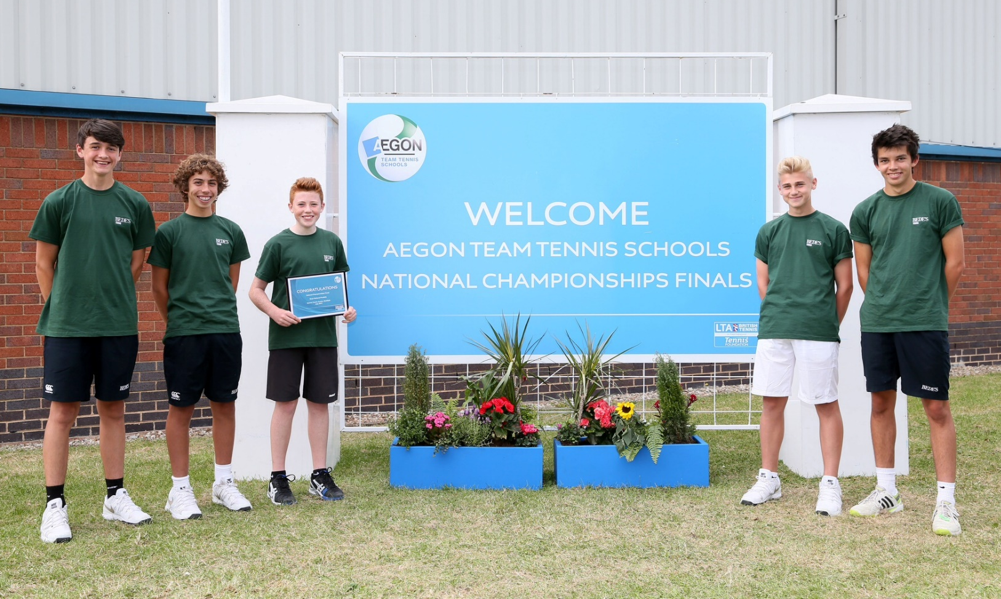
Bede’s school –Bronze- at schools Nationals in Sheffield
Boys U19 Bede’s came 10th in the Country
Boys U15 just beat Sevenoaks now into Nationals last 16
Team; Alex Abaza, Ethan Parker, Andre Bennett, Josh Goldin, Jack Burkill

Slide 42
Sussex Junior Closed Championships
Event | Winner | Event | Winner
18U Boys Doubles | Stefan Coney & James Ryan | 10U Girls Doubles | Madison Graham & Cara McCully
18U Girls Singles | Holly Thompson | 10U Boys Doubles | Lui Maxted & George Naunton
18U Boys Singles | William Matthews | 10U Girls Singles | Madison Graham
16U Girls Singles | Sonay Kartal | 10U Boys Singles | Lui Maxted
16U Boys Singles | William Matthews | 9U Mixed Doubles | William Taunton & Darcy Pycroft
14U Girls Doubles | Tiana Fox & Sonay Kartal | 9U Girls Singles | Stephanie Vieira
14U Boys Doubles | Harvey Kilsby & Emir Pinto | 9U Boys Singles | Darcy Pycroft
14U Girls Singles | Sonay Kartal | 8U Mixed Doubles | Toby Mullineux & Talitha Mitchell
14U Boys Singles | Gregor Shaw | 8U Girls Singles | Emma Videv
12U Girls Singles | Tiana Fox | 8U Boys Singles | Toby Mullineux
12U Boys Singles | Sam Nicholson

Slide 43
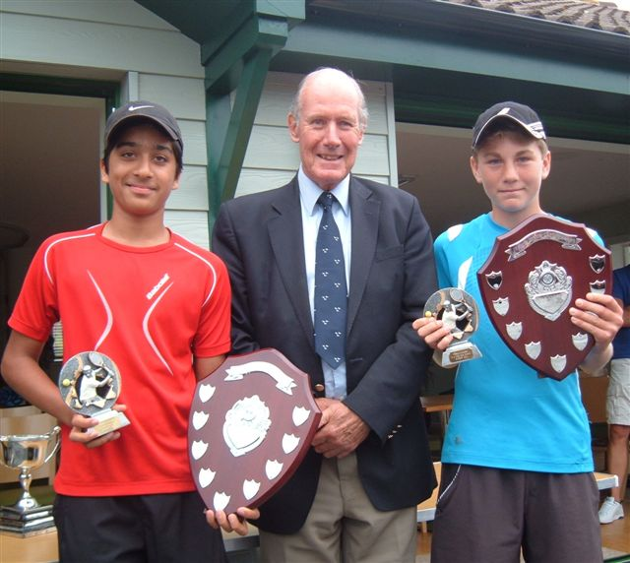
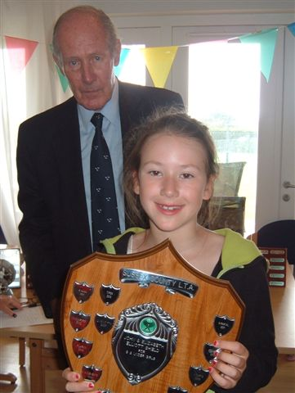
Sussex Junior Closed Championships - 3 of the Winners

Slide 44
September & October 2014
Senior Sussex postal (Veterans)
Summer Inter club matches completed
Nikki Palmer leaves LTA….
Andy Trott moves to the south west team
Anne Clark-Played for the IC (International Club) of GB vs IC of Denmark. Anne won 4 out of 4 of her matches. Team lost overall.
Anne was nominated as an Honorary member of the IC of Denmark
Nikki Palmer starts her new role-Tennis Sussex Coordinator
Sussex Ladies 40’s finish unbeaten and runners up in Div 1b. Helen Mitchell tops player stats winning all her rubbers without dropping a set
Club Forums-hosted at Virgin Active Brighton and West Worthing Club-Club volunteers and coaches learn about new LTA structure

Slide 45
Urban Tennis Foundation - Uckfield
The Urban Tennis Foundation is a new, not for profit company
Aims 'to deliver new courts for all' in Uckfield, a town that has poor tennis facilities, but a great coaching programme of 350 players per week
Ideas include an integrated schools programme, improved park court facilities and tennis for all ages and abilities
Partnering with Chailey Heritage Foundation, East Sussex Adult Learning and the children’s hospice, the Chestnut Treehouse
Great progress in obtaining funding, with works started
Summer Inter club matches completed

Slide 46

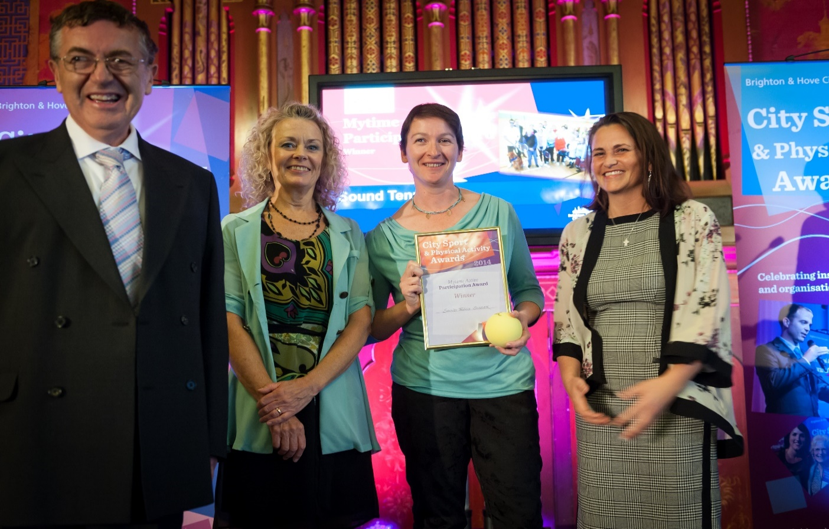
Tennis Sussex supports Sound Tennis
Chris Dutton player, Keith Turner player, Jonathan Dutton volunteer, Christine Laurence player
Sound Tennis Sussex Award Winners for the 2014 Brighton & Hove Physical Activity Award - 'running for a short time we are delighted with the positive response from our Visually Impaired community who are enjoying playing an accessible and active game

Slide 47
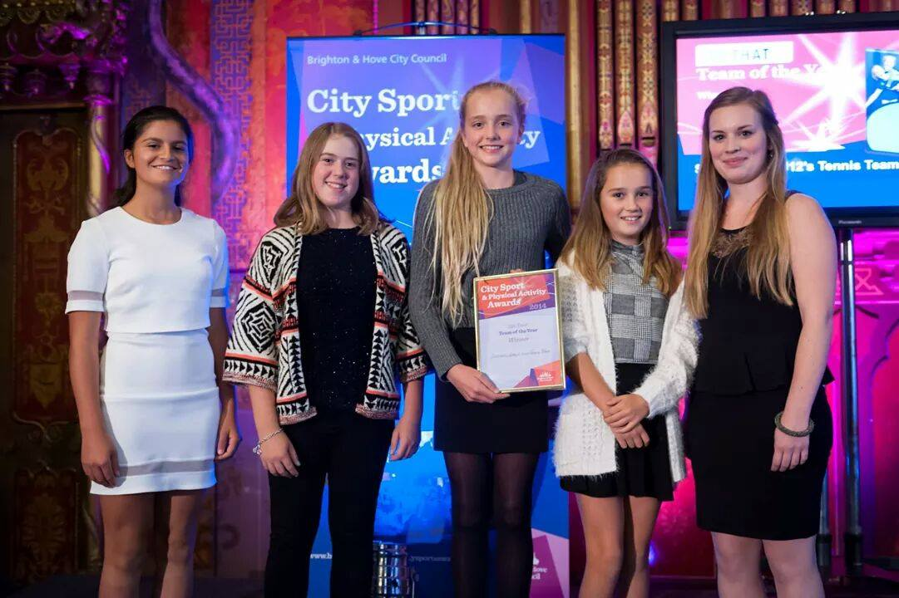
October 2014
Girls 12U County Cup team win Team of the Year at Brighton & Hove City Council City Sports Activity Awards

Slide 48
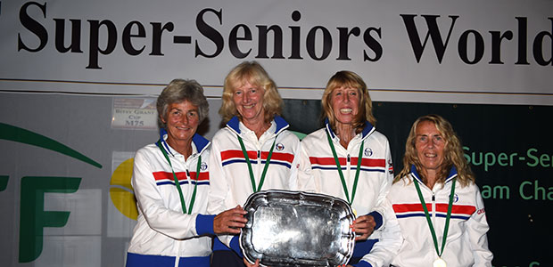
Super Seniors World Championships, Turkey
Frances Candy in the GB team – wins the 60s team event and two bronze medals in the ladies doubles and mixed individual events
+ June Peck was in the GB 65 team and won a bronze medal

Slide 49
November 2014
Frances Candy wins - LTA Senior player of the year
Greg Rusedski opens Storrington TC new clay courts
5th Tennis Sussex Awards
Barclays ATP Tour Finals 2014 -Alex Targett selected as one of the 30 prestigious Barclays Ball kids
Sound Tennis Sussex Award Winners for the 2014 Brighton & Hove Physical Activity Award-Participation Award
Liz Bartlett leaves the LTA-now spending time with her family
Chairman of Brighton Parks Tennis Association Mike Jenner won the Contribution to Sussex Sport award at The Argus Community Stars Awards ceremony

Slide 50
Leaderboard 7 November
Winter County Tour 7 Nov | Winter County Tour 7 Nov | SE Regional Tour 7 Nov | Winter National Tour 7 Nov
9U Girls | 14U Girls | 9U Girls | 12U Girls
1 Talitha Mitchell | 1 Marielle Bakhtiari | 6 Grace Tuson | 9 Tiana Fox
2 Emma Videv | 2 Mia Apps | 7 Stephanie Vieira | 18U Girls
3 Lola Dutton | 3 Olivia Stapley | 9U Boys | 9 Lauren Bishop
4 Mia Faris | 4 Katy Graydon | 2 Charlie Holmes | 18U Boys
5 Grace Tuson | 5 Ines Mathiew | 10U Girls | 9 Ryan Green
9U Boys | 14U Boys | 6 Evelyn Thoms | Aegon British Tour 7 Nov
Charlie Holmes | 1 Cameron Waller | 10U Boys | Open Women
2 William Zlattinger | 2 Alex Targett | None in top 10 | 9 Lisa Phillips
3 Noah Amin | 3 Finlay Edwards | 12U Girls | 16 Kyria Dunford
4 Toby Mullineux | 4 Harvey Kilsby | 3 Tiana Fox | Open Men
5 Evan Graham | 5 Alex Hyman | 7 Emily Gordon | 9 Keelan Oakley
10U Girls | 16U Girls | 12U Boys
1 Evelyn Thoms | 1 Hollie Irwin | 7 Lleyton Edwards
2 Grace Tuson | 2 Fay Brittain | 9 Lui Maxted
3 Imogen Mcnaughton-Ely | 16U Boys | 14U Girls
10U Boys | 1 Ethan Parker | None in top 10
1 Oliver Tutaj | 2 Luc Coulson | 14U Boys
2 Finlay Edwards | 3 Euan Rayner | None in top 10
3 Jonah Bryant | 4 Finn McCoy | 16U Girls
4 Zak Prawanna | 5 Matthew Roberts | 2 Eleanor Chapman
5 Thomas Large | 18U Girls | 8 Anna Kilsby
12U Girls | 1 Kerry-Alice Hartnett | 16U Boys
1 Evelyn Kilsby | 18U Boys | None in top 10
2 Bette Preece | 1 Oliver Dixon | 18U Girls
3 Josephine Constable | 2 Louis Shaw | None in top 10
4 Julia-Anne Van den Berg | 3 Alex Watt | 18U Boys
5 Sophia - Lubov Rudko | 3 Ross Price | 10 Logan Burgess Hayes
12U Boys | 5 Harrison Smith
1 Lemuel Cassidy
2 Lleyton Edwards
3 Lui Maxted
4 Ben Goodwin
5 Toby Bloomfield

Slide 51
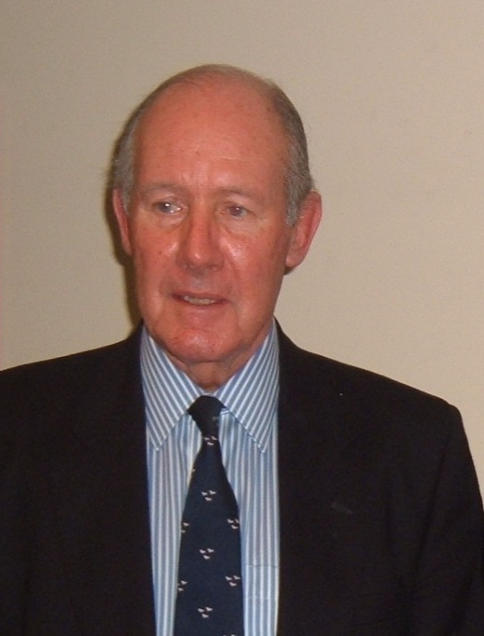
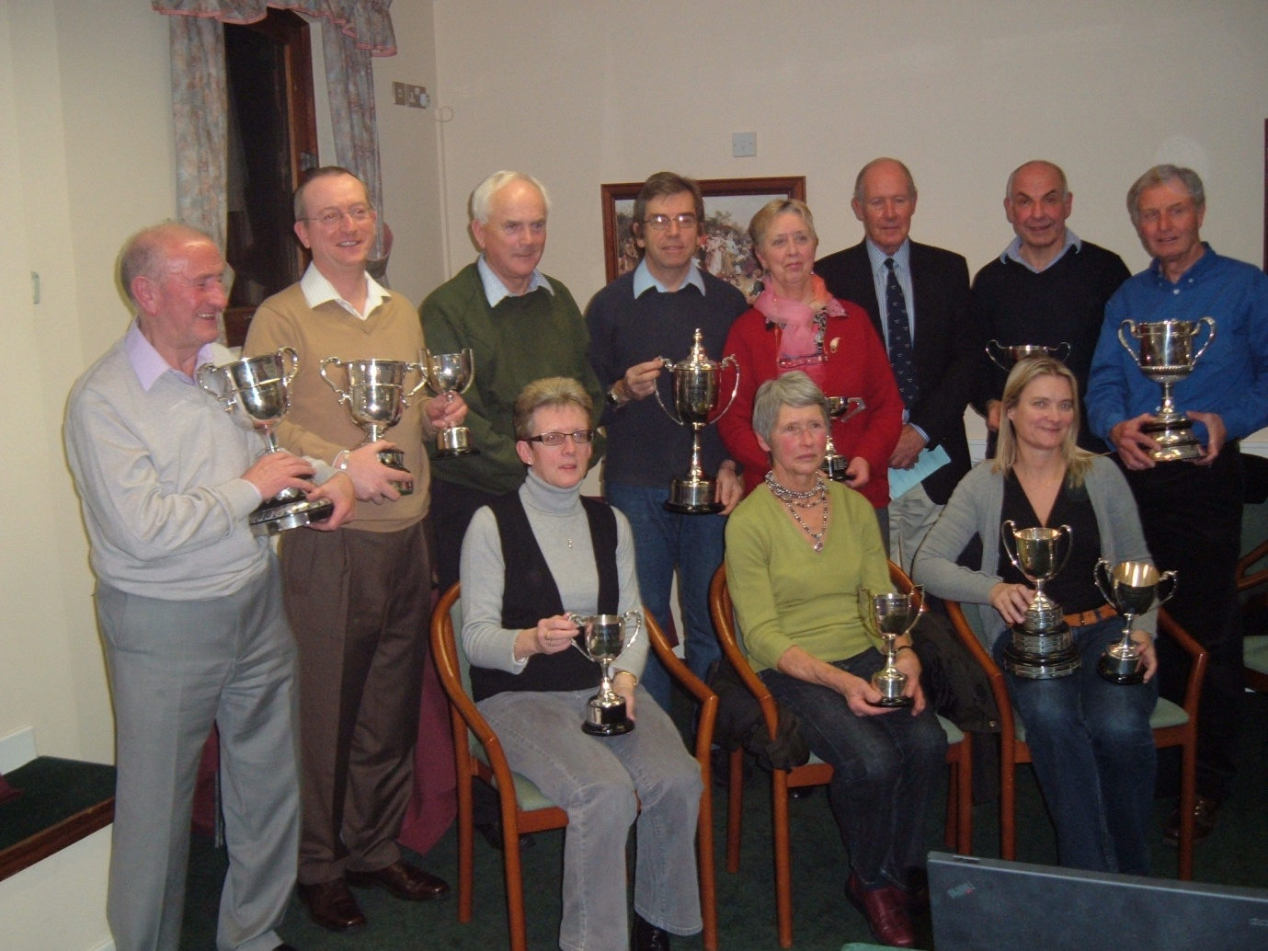
Thank you to Mike Comber and Nick Greenwood who are stepping down from the Competitions & Tournaments Committee after 28 and 20 years

Slide 52
Thank You
Thank you to our Tennis Sussex Awards Sponsors:
  RT Williams
  Packaging Advantage
  James Ross Jewellers
Thank you to - Jack The Lad from Heart Sussex & Surrey Breakfast Radio show
Thank you to Keith Pullin
Thank you to Julie Goldin, Phil Latham, Liz Bartlett, Rob Hempenstall and Chris Stone for all their contributions to get the show on the road
Thank you to the Amex for hosting Tennis Sussex Awards

Slide 53
Thank You
Thank you for coming

Slide 54
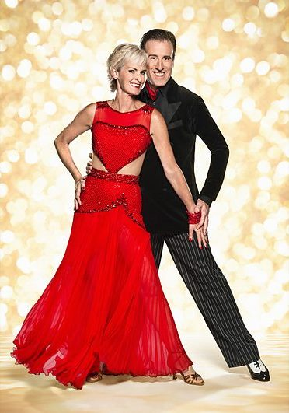
Keep playing………..

