Slide 1
Leicestershire – April 2013
Local Area Club & Volunteer Forums

Slide 2
Content
        Club Leaders
          What is on offer
          How the programme can support you and your venue
          Promotion of your Tennis Venue
            What support do you need and how can we help?
        Safeguarding and Equality, Diversity and Inclusion Updates
          New training, who is it for, how to safely recruit a coach

Slide 3

Club Leaders
What is Club Leaders?
Part of the Places People Play Olympic and Paralympic legacy programme
Uniquely focused on the business aspects of club management
Tailored for sports clubs
Working to provide better business skills for club leaders
A national programme
Available to all clubs
It’s all FREE!
Notes:
Club Leaders is a new program making up part of the Olympic and Paralympic legacy. The focus is on providing better business skills for sport through workshops, seminars and resources.
The support has all been tailored specifically for sports clubs to ensure the right people are providing the right information and to address challenges faced specifically in sport.
The programme is available throughout England but online modules can be accessed elsewhere.
And, as with previous sport England programmes – all of the training and support is free!

Slide 4
Club Leaders
What support is available?
Training and support is being delivered by PwC, who are working with Sport England to bring their knowledge and experience in this area to the programme, via:
A dynamic Club Leaders website with e-learning modules, downloadable toolkits and templates, and discussion forums
Face to face seminars led by subject matter experts across the country
One-to-one mentoring to focus on those clubs most in need to get them on the right track.
Notes:
The range of training and support on offer is wide and continues to grow.
The Club leaders team are providing support in a range of ways, both on and off line.
The seminars can be sport specific or delivered in a local area to a number of clubs from different sports.
The team are keen that the information provided is relevant and useful so will liaise with clubs prior to the event.
The mentoring is proving successful so far and two tennis clubs are being mentored at the moment. The mentor is a professional with relevant expertise from the world of business who will help a club overcome challenges they are facing in developing their venue.

Slide 5
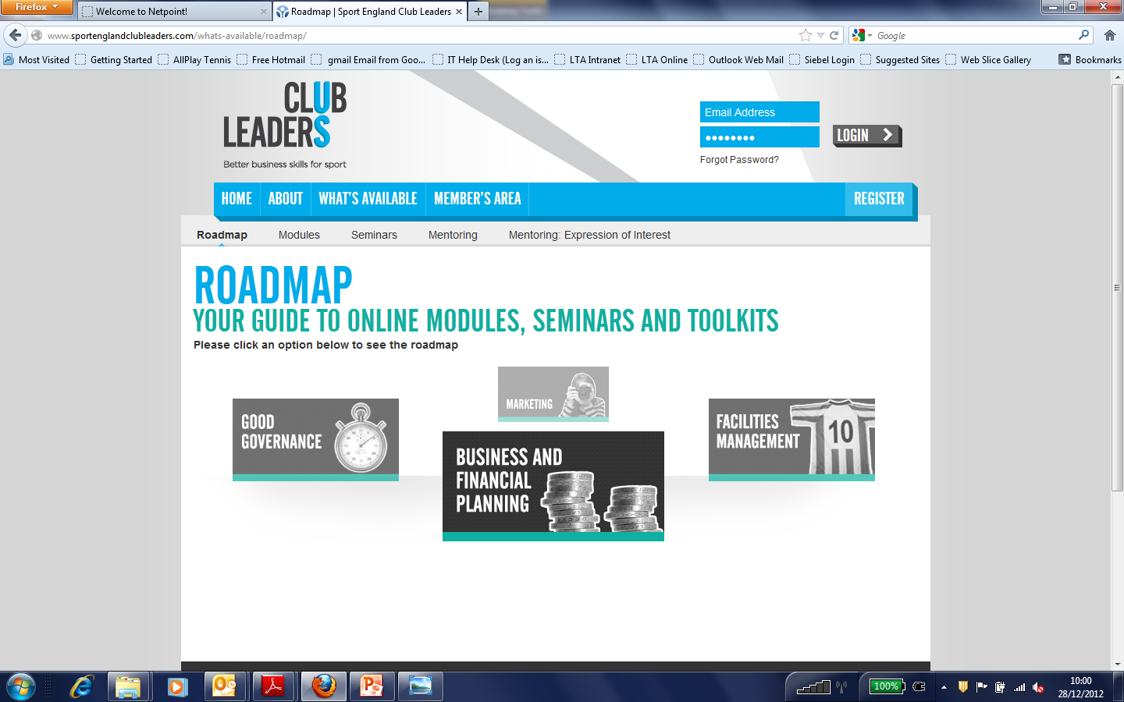
Club Leaders
How to find out more
Visit the Club Leaders website at: www.sportenglandclubleaders.com
Notes:
The subjects available so far…

Slide 6
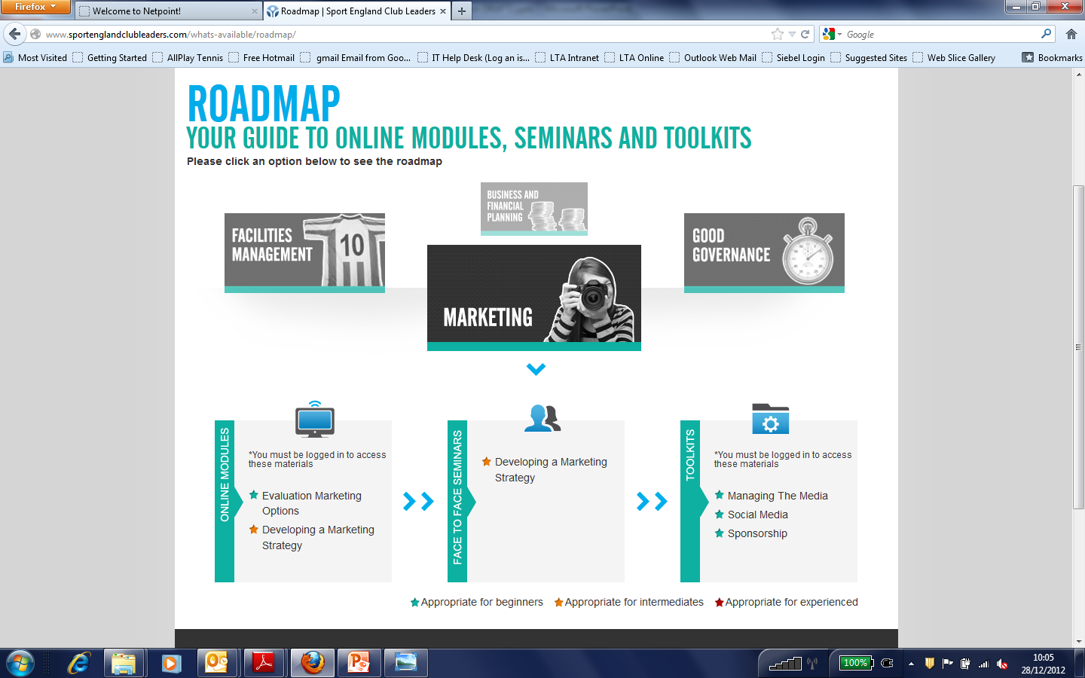
Club Leaders
Notes:
A screen shot of the types of things available. All modules etc are categorised into who they are suitable for: beginner, intermediate.

Slide 7
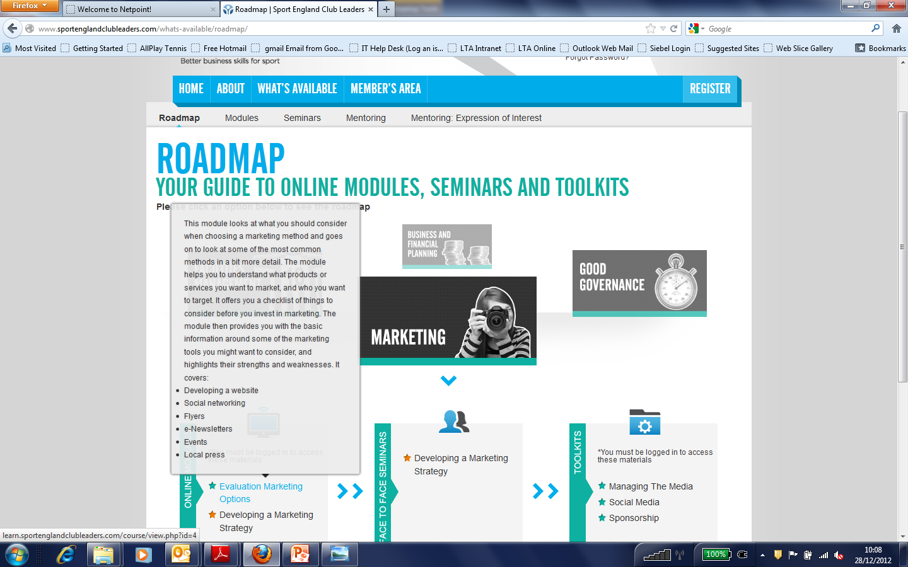
Club Leaders
Notes:
Just to give a little more detail – this is the sort of information the website gives about the training on offer. Helps to ensure you’re looking at the right support, at the right level for your expertise.

Slide 8
Club Leaders
How to get involved
Register on the Club Leaders website
Receive monthly emails on support available, updates etc.
Expression of interest for mentoring (two tennis clubs already receiving mentoring – one nominated by NGB, one self nominated)
Organising seminars with other local clubs
Any questions about the Club Leaders programme?

Slide 9
Promoting Your Tennis Venue
We want to help you to promote your venue to increase membership and participation.
What can the LTA help you with to better promote your venue?
Promotional materials
Marketing strategies
Resources (online tool kits, physical resources)
Anything else?
Please use the next 10 minutes to discuss with others before feeding back.
Notes:
This is part of a wider project within the LTA. We want to be able to provide the right tools and resources to tennis venues so that they are able to effectively promote their offer. This is work in progress, but in order to ensure we’re on the right track it would be useful to have some feedback and ideas from people in clubs and other venues.

Slide 10

Safety and Well-being in Tennis
Policy Update
Safeguarding Children and Young People Policy
Safeguarding Adults Policy
Three tiered approach:
Notes:
The updating of policies has happened to ensure that we continue to implement best practice across British Tennis so that everyone who wants to participate can do so in a safe, inclusive and respectful environment.
The LTA and TF are committed to safeguarding children, young people and adults deemed at risk. This has resulted in separate children & young people and safeguarding adults policies.
The image shows the new Safeguarding branding that can be seen across the policy and also on the new Safeguarding web pages. The three tiers outline the LTA and TF approach to safety and well-being in tennis.

Slide 11
Safety and Well-Being Three Tiers
Early intervention – taking steps to raise awareness of best practice as well as potential issues and taking appropriate steps to minimise risks;
Prevention – taking steps when an identified issue places someone at risk or may place someone at risk of harm;
Protection – taking steps when someone is identified as being at risk of harm or where abuse has occurred. Always dial 999 in an emergency.
Notes:
The information in our two policies along with the newly developed training provides details about what to do in a variety of situations, in line with the three tiers:
1. taking steps to raise awareness of best practice as well as potential issues and taking appropriate steps to minimise risks
2. taking steps when an identified issue places someone at risk or may place someone at risk of harm. The LTA safeguarding team can offer support and information and advice to you and tennis venues to help manage and learn from these situations
3. taking steps when someone is identified as being at risk or harm or where abuse has occurred. Remember, always dial 999 in an emergency.

Slide 12
Equality, Diversity & Inclusion
Policy Update
Equality, Diversity and Inclusion is considered and championed throughout all aspects of the organisation
The policy explicitly outlines the LTA’s commitment to equality, diversity and inclusion and conduct and expected behaviour from everyone involved in British Tennis.
Not “tick-box” policies
Inform and influence how tennis venues run
Help embed ethos, messaging & minimum standards
Backed up by the Safety and Well-Being in tennis, and Equality, Diversity and Inclusion training
Notes:
The LTA and TF are committed to ensuring British Tennis remains open, accepting and accessible to all sections of the community.
To achieve this commitment we consider and champion EDI issues throughout all aspects of the organisation by welcoming diversity, accepting difference and challenging all forms of discrimination and unjust behaviour.
The EDI policy outlines the organisations commitment to EDI issues and how delivering on this commitment will help achieve organisation priorities. It clearly outlines the conduct and behaviour expected from everyone involved in British Tennis.
It is essential that both Safety and well-being and EDI policies are not seen as tick box or simply a paper exercise.
They must inform and influence the way tennis venues are run and the behaviour and conduct of all participants.
To help embed the ethos, messaging and minimum standards outlined in the policies, the LTA has created the Safety and Well-Being in tennis training and the EDI training.

Slide 13
Safety and Well-Being Training
A proactive and positive approach to promoting safety and well-being on children, young people and adults deemed at risk.
The training introduces the traffic light system to identify a range of situation and how to respond, regardless of your role within a tennis venue.
It also empathises that if we get things right in the “green” area, then we reduce the number of “amber” issues and the possibility of them escalating to the “red” issues.
Notes:
The training outcomes include:
Green
Know and understand the term “well-being” and understand what it means in terms of your legal obligations
Understanding safeguarding from differing perspectives (tennis venue, tennis people, juniors, adults, parents, coaches, adults at risk, officials)
Amber
Understand how to use a range of preventative measures and explore aspects of early intervention
Understand the importance of the role of your welfare officer
Red
Respond to safety issues and well-being challenges positively so that the situation constructively helps to improve things for the future
Know and understand the role of the LTA safeguarding team and how they can help with amber issues and the most serious safeguarding (red) issues
Know that some serious issues require the involvement of the Local Authority Social Care services and / or the Police.

Slide 14
Equality, Diversity & Inclusion Training
The EDI training looks at how to ensure your tennis venue is creating the right environment, maximising its potential to increase participation and how to manage and challenge difficult situations.
The training covers a wide range of areas protected by law including: age, disability, ethnicity, sexual orientation; religion; gender, gender reassignment. It also highlights how these issues need to be considered by tennis venues.
Notes:
The training outcomes include:
Defining equality, diversity and inclusion and its relationship to tennis
Knowing and understanding the purpose of the LTA E&D Policy and how this can be implemented within tennis
Knowing and understanding the legal context for E&D
Exploring the protected characteristics and how these are represented in tennis
Ability to manage complex situations that involve protected characteristics
Understanding the power and impact of language and ensuring all incidents of inappropriate language and behaviour are challenged
Confidence in responding to E,D&I issues and understanding the impact of not responding.

Slide 15
Training – booking and prices
Safety and Well-Being training will be a compulsory requirement for all Licensed and Registered coaches renewing their accreditation in 2014
Equality, Diversity & Inclusion training will be compulsory for coaches renewing their licence in 2015
Courses will be run by Coach Education Centres for £30
Each club will receive 2 free places for volunteers on each training session
Coaches will receive 3 License credits for each and the training will be valid for three years
To find a training session in your local area go to www.LTA.org.uk or contact the Coach Education Centres directly.
Notes:
List of Coach education centres
Inspire2coach
Ucoach
Bromley
Leeds Met
http://www.lta.org.uk/Coaches-coaching-assistants/Coach-Education-Centres1/

Slide 16
Clubmark Updates
Club Pledge
All Clubmark clubs will be provided with a Club Pledge
The Pledge will also display the government charter to tackle homophobia and transphobia in sport
Policies
Policies have been updated in response to the needs of tennis venues and people to ensure we remain progressive
Updated policies, guidance and templates can be found online in the Clubmark section of the website and need to be replaced by venues.
Notes:
Club Pledge
LTA will provide all Clubmarked clubs with a newly designed Club Pledge that outlines the policies the club has in place, expected behaviour and conduct, and identifies the Welfare Officer.
This replaces the need for clubs to display all the difference policies required for clubmark.
This means the policies need to be kept in an easily accessible place so all members can view the policies
The pledge will also display the gov’t charter to tackle homophobia and transphobia in sport, which is a requirement for clubmark clubs.
This will further demonstrate the club’s commitment to ED and send a positive message of inclusion to all members, visitors and prospective visitors.
Policies
Policies have been updated in response to the need of tennis people and tennis venues to ensure we remain progressive and can best serve British Tennis.
The updated policies, guidance and templates can all be found online at the newly designed clubmark section of the website
All new policies need to replace previous versions and tennis venues must ensure they communicate the changes to their workforce, volunteers and members
One change to note is the requirement that the head coach and at least one volunteer must undertake the EDI training.

Slide 17
Welfare Officer Role
Formally Child Protection Officer
As is clear from previous slides, and outlined in the new training, the role of safeguarding is broadening to include adults at risk – this has led to the change of title.
Task – ensure you know who your Welfare Officer is and that the person is recorded correctly on the Self-Service area. This information also needs to be clearly displayed at your tennis venue.
Notes:
The role of the welfare officer will be published on the website, in role descriptions. This is also covered in the training.
The Safeguarding team will be communicating with welfare officers directly on a regular basis which is why it’s important we know who the right people are and how to contact them.

Slide 18
Thank you
Any questions?

