Slide 1
Club Forum
Spring 2016

Slide 2
Agenda
Update from 2015
Resources 2016
County Update
Main Topic Items
    How to recruit volunteers
    How to grow and retain membership
Summary of Call to Actions
Q&A

Slide 3

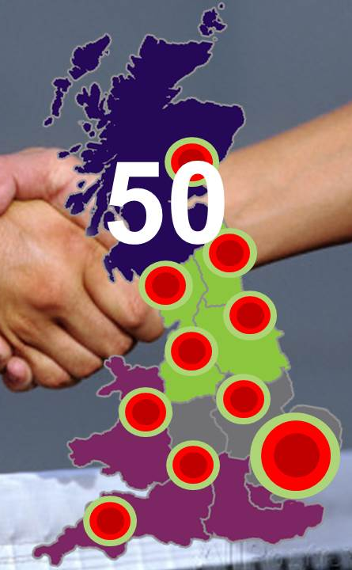
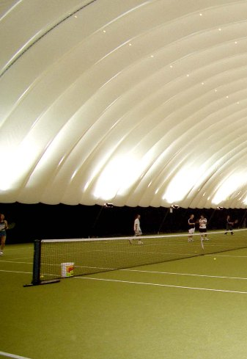
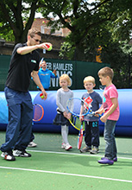
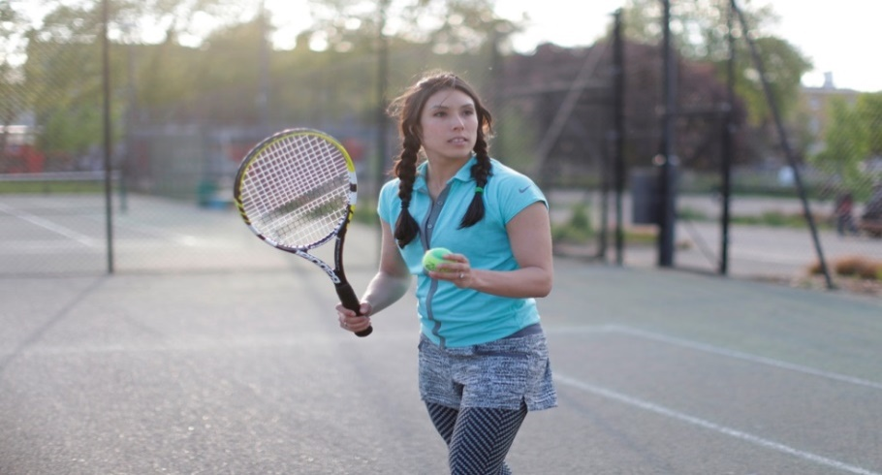

Progress - Participation Strategy 16-18
Create strong pockets of tennis in clubs and parks through local delivery partnerships
Improve facilities and related technology to ensure year round play
Make tennis an option through creating relevant and innovative products for every need
Break down misconceptions of tennis amongst local communities and non club players
Delivering an engaged and motivated tennis workforce
Notes:
We are now 12 months into our new Participation Strategy and we are building on the progress made last year both on and off the court. As we know last year was a special year on the court and that success is continuing into 2016 – Following our historic Davis Cup win, we have the continued excellence of Murray brothers, Jo Konta reaching the semi finals at the Australian Open, a new grandslam wheelchair winner in Gordon Reid on the back Jordanne Whiley’s success at last years US Open.
Such success is giving our sport unprecedented media exposure and as a result is giving us a great platform to help get more players play more often
As we look at progress against our strategy, we are accelerating our growth across the key strands we set last year. We are working more closely with LA’s – and hope to progress work with 50 LA’s this next year.
We feel we are starting to provide more meaningful and better support to you our club network through the development of resources to help you be the best you can be. (Can Add a couple of Regional examples).
We are continuing to expand our funding support to help clubs and community venues improve facilities – add any regional examples
We are developing our support to attract and develop new coaches and volunteers while supporting better those really running our sport – mention Davis Cup Legacy program and volunteer toolkit -
We are designing creative and innovative products designed to attract particular types and segments of people who are telling us they want to enjoy our sport
We also are looking this next year to create a demand for our sport while also breaking down miss-conceptions about our sport – ie its elitist, expensive etc

Slide 4
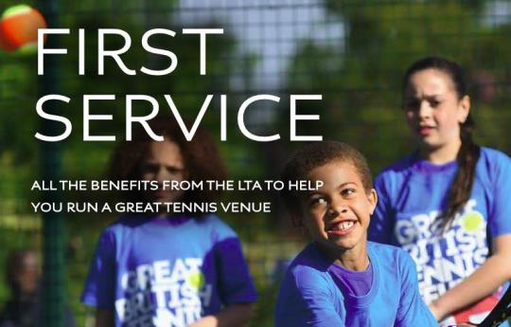


Key Resources for Clubs
Are you making the most of the benefits and support associated with your LTA Venue Registration?
(https://www.lta.org.uk/venue-management/venue-registration/)
Need financial help in developing your facilities? Check out the LTA Facility Funding Guide
(https://www.lta.org.uk/venue-management/facilities-advice/)
Notes:
From the feedback in our clubs surveys you told us that you would like more support to help you run your clubs and make administration easier.
So- Last year we launched the First Service guide. Don’t forget to take a read to understand all of what your registration offers you. Ask your Regional Team for a copy or download it from the LTA website (https://www.lta.org.uk/venue-management/venue-registration. Have copies available to give out on the night.
Many of you said you Need financial help in developing your facilities? Check out the LTA Facility Funding Guide for advice on the support available.
You also said you wanted help to make administration easier – so we launched additional clubspark modules and to help get started we ran introductory training courses last year for x no of clubs in our Region. We will now look to provide more bespoke support to help clubs start to use the program to best effect. Could give a regional/local example

Slide 5
Resources Available 2016
Spring 2016

Slide 6

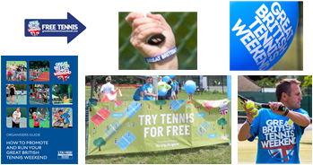


Great British Tennis Weekend
May 14th & 15th
July 16th & 17th
^{…or anytime!}
^{Key Priorities}
- Quality Participant Experience
- Membership & Programme Conversion
- Check In App / Data Collection
Action: Go to ClubSpark and publish your 2016 GBTW event(s) now!
Notes:
*There is an accompanying FAQ’s document for anything you might need to know about GBTW for this section*
2016 will be the 4th year and the main purpose still remains the attraction of new families and tennis players to your programmes and venues. All parts of the campaign are being continuously improved off the back of feedback we get from you as coaches, so thank you for helping to make it a success in the last few years. We’re always looking to build on what we’ve got already though, so if you have any feedback you’d like to give today, or if you’d like to grab me afterwards or even send an email into the Participation inbox, we’d love to hear your thoughts and ideas.
Based on feedback from venues and coaches in the last couple of years, there will be two nationally promoted weekends for GBTW 2016. May was the month in which the majority of venues said they were looking to run events, and July was a really popular one in 2014, which was missed by some venues in 2015. It provides a great opportunity to utilise Wimbledon and the noise around tennis in general to generate bookings for GBTW to bring new people into the sport. However, it was fed back that some venues understandably had difficulty fitting an event into the specified weekends, so this year our supporting resources will be provided to anyone running a Great British Tennis Weekend between April and August, and hopefully with the support of your local LTA regional team you’ll be able to create a real buzz about your event. That being said, we do recommend that if you’re able to run an event on one of the promoted weekends, you will almost certainly be able to attract more bookings.
There is support available for all participating venues and coaches in the form of a resource pack, much like last year’s Venue Pack. Within this you’ll get things like t-shirts, an Organisers’ Guide booklet and resources to promote and run your event. A key improvement to the promotional materials for this year is that the posters and postcards will be personalised with your venue’s name and event dates, so that they’re ready made for you to give out in the local area.
A couple of quick points on the priorities of the campaign, firstly to say thank you. 9 out of 10 of people that come to a GBTW say they are really satisfied with their experience, so you guys have to be congratulated for spearheading that and hopefully we can get even better in 2016. However, it means nothing unless we keep these people playing tennis. We’re going to provide you with as much guidance as possible to run follow on offers and discounts for people to sign up to memberships and programmes at your venues. Finally, for our own benefit and for yours, please use the GBTW Check In App to record your players as they arrive. It looks really professional and instantly updates your ClubSpark system with the data you collect.
If there’s one other thing that could inspire you to run the event, we’re running a prize draw this year, whereby all venues that run an event will be in the running to win a trip to La Manga for a group of six people. Exciting stuff!

Slide 7

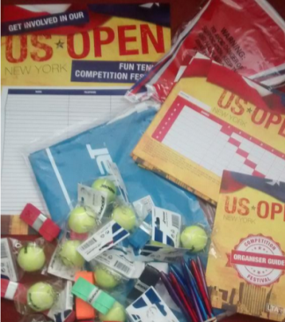
Benenden Tennis Festivals
Following 2015’s US Open and Davis Cup Packs, we are delighted to have a sponsor to support our Tennis Festivals – Benenden
A series of fun themed competitions for players of all ages run by their local venue
Four themed tennis competition festivals are planned for 2016 with some exciting packs to help support our venues
The festivals are a great way to encourage families to lead healthy lifestyles through tennis and be part of a health and wellbeing community that Benenden are at the heart of
Notes:
*There is an accompanying FAQ’s document for anything you might need to know about Benenden Tennis Festivals for this section*
Benenden Tennis Festivals are a series of nationally run recreational competitions that clubs and tennis venues have the opportunity to run. They are a progression from the Competition Festivals that ran last year alongside the latter stages of the Davis Cup and the US Open.
There are four key milestones in the year that the festivals will be timetabled alongside, and they are a great way of encouraging families to lead healthy lifestyles and play tennis together.

Slide 8
Benenden Tennis Festivals
The four festivals in the calendar for 2016 are:
    Davis Cup – March
    Grass Court Season – June/July
    American Hard Court Season – August/September
    Halloween – October/November
Sign up around 6 weeks before each festival and you’ll receive a pack.
Action: Sign up online at www.lta.org.uk/benendentennisfestivals
Notes:
The four times in the year that the Festivals will run are alongside the Davis Cup home tie against Japan, the grass court season and Wimbledon in the summer, the US Open and the hard court season in the autumn, and Halloween!
If you’re going to run an event, sign yourselves up via the link below around six weeks before each festival, so that you receive the festival pack. The pack is everything you need to run a recreational tournament, including drawsheets, flyers, posters and much more.
*You will have an example pack to talk through provided by your region’s RTCC*

Slide 9




Fast 4 Competition Formats
FAST4 Tennis provides a simple, exciting way of speeding up a conventional tennis match.
    Time – Life is busy and many players can no longer commit a whole day. The matches rarely take more than an hour (usually 45 minutes or less) so align to standard court booking slots.
    Additional revenue opportunities - you can run draws up to 16 players on one day and as matches are quicker your court fees will be reduced.
    New and exciting – to encourage both current and new players. FAST4 has been endorsed and has been played by some greats of the game.
    Overview video of Fast4
    https://www.lta.org.uk/play/types-of-tennis/fast4-tennis/
Notes:
We wanted to bring to your attention an exciting new scoring and competition format in tennis – Fast 4.
It was launched just over a year ago in Australia and has been well received worldwide, with the ITF even recognising the format in their Official Rules of Tennis for at least the next two years.
In the UK, it was used for all junior Grade 4’s and 5’s over the winter period just gone. Competition organisers said it was far easier to organise their competitions, because of the shorter time period over which matches and tournaments can be played, and therefore more players they can have entering, which in term generates more revenue.
Within your own venues, you may want to think about the shorter match format and how you could use that to encourage more competitions for your players. The shorter and potentially more exciting scoring format allows for people with limited time the opportunity to play multiple matches in one evening.
When you receive these slides after today, take a look at the YouTube video and the page on the LTA website if you’d like some more information.

Slide 10
Clubspark Update
COMMUNITY
AVAILABLE
OPEN DAYS
PILOT
COMPETITIONS
IN DEVELOPMENT
COURT BOOKINGS
On site technology
CLUBSPARK
MEMBER MANAGEMENT
APPS
CONTACTS
COACHING
WEBSITE MANAGER
CAMPAIGN WEBSITES
Notes:
Open Days
Used for running GBTW events
Court Booking
Customisable booking rules you can vary across courts, membership packages, coaches, team captains, times of the year and many more
Online payments and automatic refunds (where you want them)
Provide your players with the booking app (android and ios)
Member Management
Create as many packages as you want
Individual and group packages
Traditional fixed date membership or rolling from date of purchase options
Online payment, including direct debit instalments
Other ‘offline’ payment methods can be set
Automatic renewals
Promote you packages online to new members
Support from Sportlabs in setting up packages and uploading existing members
Contacts
Single database for all your contacts
Anyone who accesses your venue through ClubSpark will become a contact (e.g. from a GBTW, booking a court, signing up for membership, booking a coaching session)
Filter the data and send emails direct from the system
Set your own data protection consents players sign up to
Campaign Websites
Automatically have your activities promoted on LTA campaign websites like GBTW, Tennis Tuesdays and Mini Tennis without and extra effort
Website Manager
Have your own (free) website through the system, integrating the other features you are using
Set template so limited flexibility
Includes home page, membership, booking, coaching, contact and 2 custom pages
Competition and events will be added when those modules are ready
Coaching
Run both LTA campaigns and regular coaching programmes
Take online bookings and payments
Manage attendance and email players through the system
Link to sessions from existing websites or automatically promote on a ClubSpark website
Apps
GBTW Checkin app – manage bookings and attendees at your events
ClubSpark Coaching app – manage bookings and attendees on your coaching programmes
ClubSpark Booker app – members and players can check availability and book courts at your venue
On Site Technology
Piloting in 2015 – gate access solution to allow players to securely access no-manned facility
Book online, receive code via email or text and use code on keypad to access courts
Competitions
Tools to manage recreation competition phased delivery expected through winter 2015 and Q1 2016
Community
Customisable email templates for newsletter style emails
Member to member communication e.g. match arranger

Slide 11

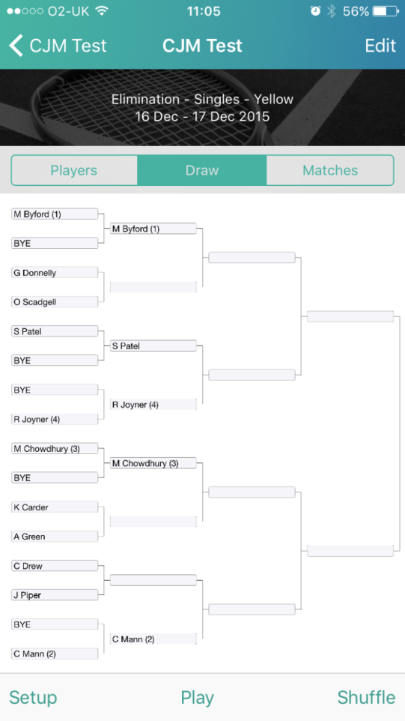
Clubspark Competition Module
An easy way to run local recreational competitions and tournaments from your smartphone
6 different formats – Matchplay, Results Manager, Compass, Elimination, Elimination with Consolation, Round Robin
Download players from your venue’s British Tennis Membership list
Option to submit for LTA ratings
IOS and Android APP version available for the start of the summer season
If you need help or more information – contact your regional office
Notes:
Building on our online Clubspark Management tool and to help make tournament administration easier, we have added a new Competitions module to ClubSpark, and with it comes a shiny new app for your phone or tablet, that will be launched by April, in time for the summer season. It is to provide an easy way to run local recreational competitions and tournaments from your smartphone or tablet.
You’re able to run tournaments in 6 different formats – whether you’re hosting a Matchplay, uploading results via Results Manager, Compass draw, Elimination, Elimination with Consolation or Round Robin
You can also download players on to the app from your venue’s list of BTM’s, AND there is an option via the Competitions module to submit results that are eligible for LTA ratings.
If you want any more information or guidance on this, get in touch with your regional team.

Slide 12
Calendar of Training Opportunities
Region to add dates and calendar
How to sign up

Slide 13
County Update
Spring 2016

Slide 14
County Update
Please add

Slide 15
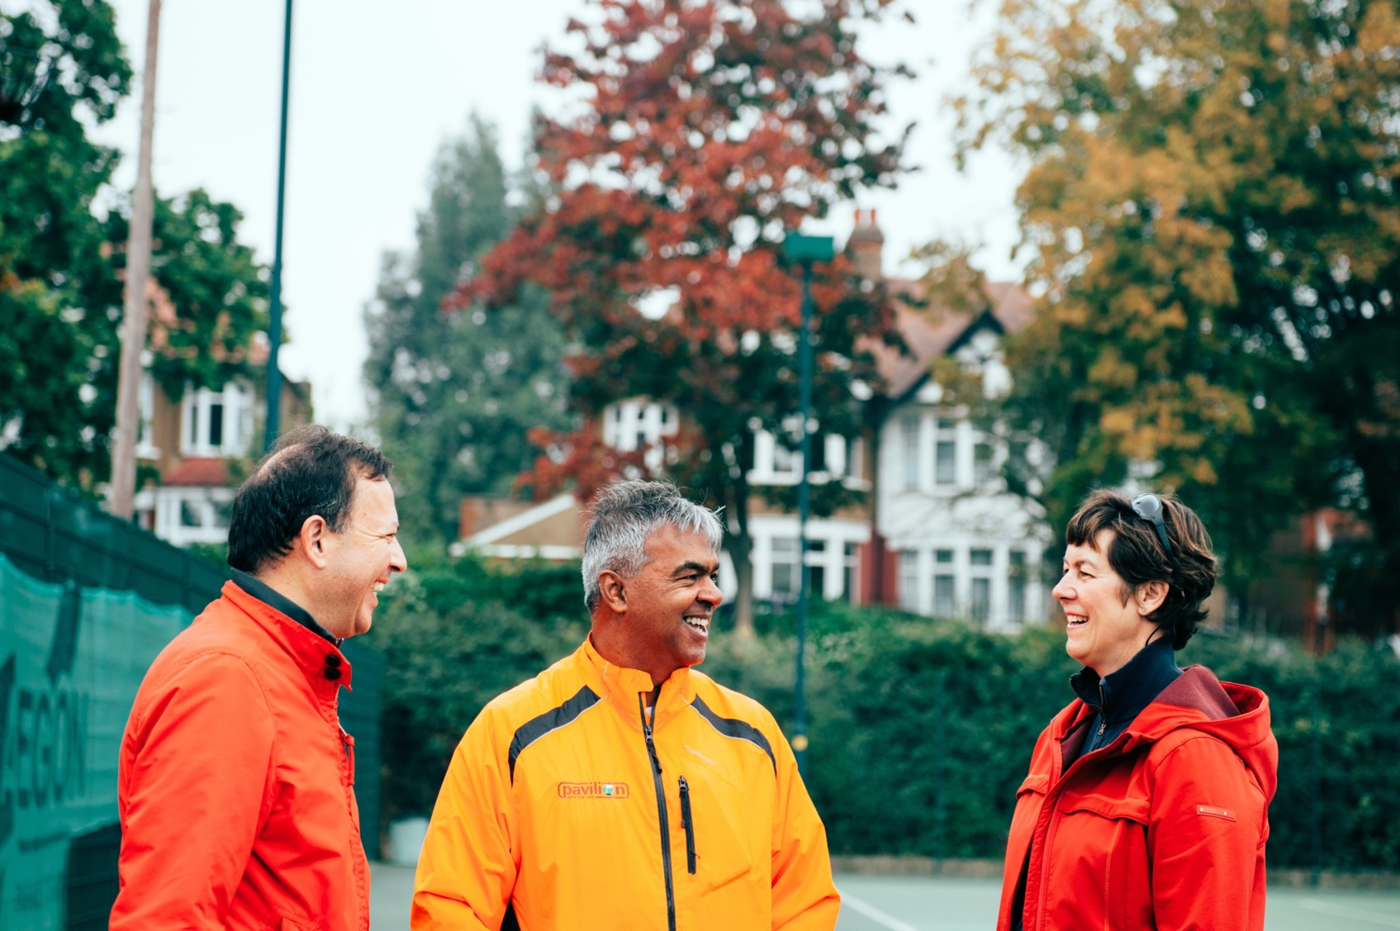
How to attract
more volunteers
Notes:
In the club survey 63% clubs need more volunteers. Today we are here to show:
What’s working in other tennis venues, other sports, other volunteer bodies
Our new online volunteer toolkit
Tips for using volunteers at open days.
*****TALK ABOUT YOUR OWN VOLUNTEER EXPERIENCE TO GAIN CREDIBILITY – YOU ARE NOT JUST A PAID MEMBER OF STAFF*****
Other stats to help set the scene
82% volunteers aged 45-64, only 5% 16-34
53% have been volunteering for 5yrs or more, only 1% have become a volunteer in the last 6 months
Ageing population, over half saying they wont be volunteering in 5 years time so a real challenge to recruit more
Each new sports volunteer enables 8.5 new participants

Slide 16
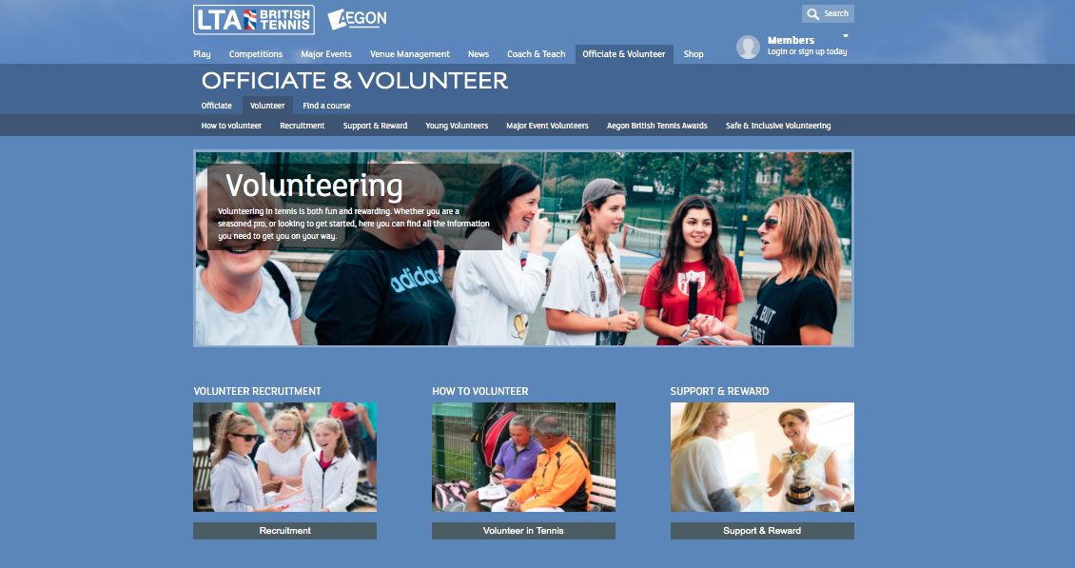
Online support: www.lta.org.uk/tennisvolunteer
Notes:
We have developed this toolkit following venue feedback:
Role descriptions for typical volunteers
Ideas for how to advertise for volunteers
How to support and thank your volunteers
Safe and inclusive guidance
Lots of templates and resources – PLEASE USE!

Slide 17
The four steps that can make a difference
1
2
1. Appoint
a volunteer
co-ordinator
2. Be prepared
3
4
3. Look at your members
4. Reach out into your local community
Notes:
Advice is broken down into four core areas

Slide 18
The four steps that can make a difference
2
1. Appoint
a volunteer
co-ordinator
3
4

Slide 19
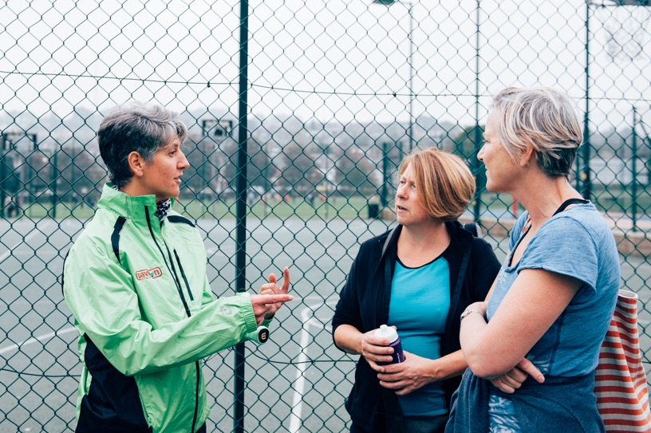
1. Appoint a volunteer co-ordinator
What is it?
A figurehead for your volunteers
Takes responsibility for bringing in new people
Provides support and advice
Says thank you
Notes:
200 clubs have a volunteer co-ordinator
Ran a pilot with volunteer charity Join In last year – 10 clubs who appointed a volunteer co-ordinator and recruited new volunteers

Slide 20
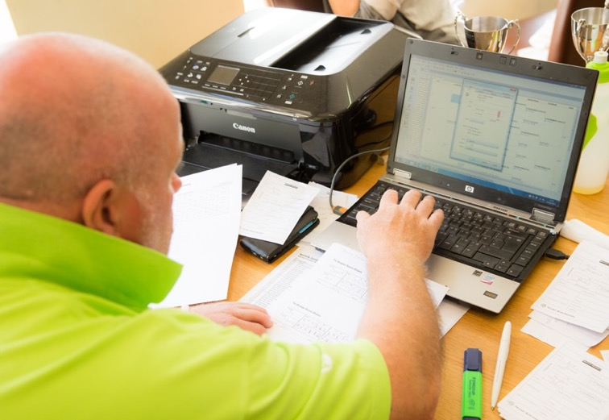
Volunteer co-ordinator
Who is it?
It could be an existing person – chair or secretary
A regular committee member
It could be a member who hasn’t got involved before
Action: Put this item on the agenda at your next meeting – with some ideas on who could do this.

Slide 21
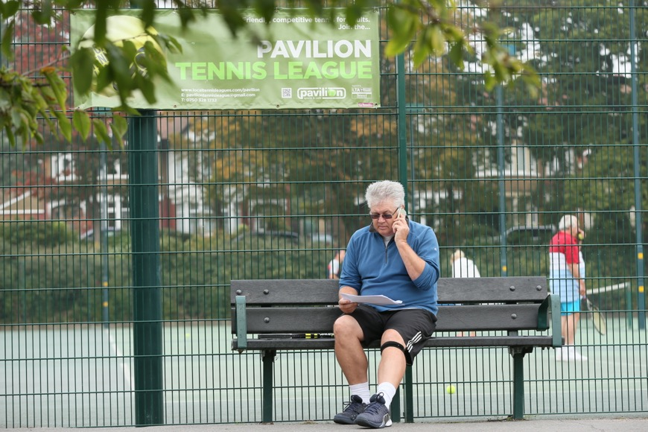
Volunteer co-ordinator
What skills do they have?
Good listener
Good communicator
Well-organised
Reliable
What values do they have?
Passion
Teamwork
Integrity
Excellence
Notes:
You may have someone in mind who would work well

Slide 22
The four steps that can make a difference
1
2. Be prepared
3
4
Notes:
Preparation is key – if you do your homework, you will get better results!

Slide 23
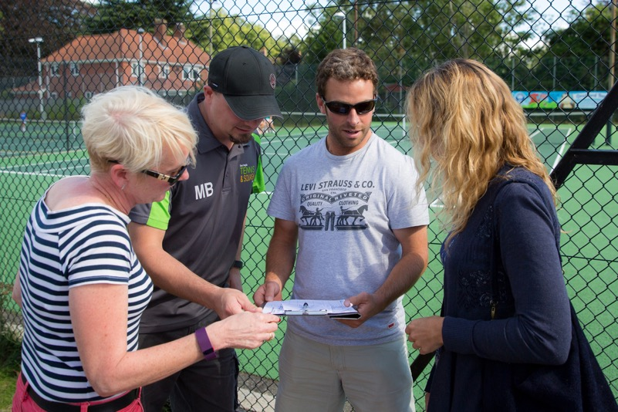
2. Be prepared
What roles are you missing?
Do any of your current volunteers need extra help?
What skills are you looking for?
What’s the time commitment?
Action: Spend some time with your committee mapping out your ‘must-have’ and ‘would-like-to-have’ lists.

Slide 24
Download template role descriptions
      Administrator Ballot administrator
      Chairperson
      Club main contact Committee member
      Competition organiser Grants & funding officer
      Juniors captain/contact
      Marketing/communications officer
      Match secretary Membership secretary Mini Tennis contact
      Performance programme manager Schools co-ordinator Secretary
      Seniors captain/contact
      Social media co-ordinator Social secretary
      Tennismark lead Treasurer Volunteer co-ordinator
      Website editor Welfare officer
Action: Visit the website: www.lta.org.uk/tennisvolunteer
to download and use
Notes:
Currently 20
Let us know if you need others

Slide 25

What skills should a volunteer have?
Notes:
Think about who is a good ambassador for your venue

Slide 26
Volunteering is fun and rewarding, but we need to ensure safe recruitment is embedded in the process.
Notes:
Just be aware!
Volunteering can be an easy way for people to obtain positions of trust and authority to get access to children
Ensure you put simple measures in place to make sure volunteers & members are safe

Slide 27
Safe and inclusive recruitment tips
Advertise all roles, even informally
What if a volunteer has a disability?
Have an informal interview
Talk about why creating a safe and inclusive tennis environment is vital
Do they need a DBS check?
Enrol them on an LTA Safeguarding and Protection in Tennis course
Action: Find out more at www.lta.org.uk/tennisvolunteer and in the LTA ‘What’s the Score?’ toolkit (pages 54-55)
Notes:
DBS – needed if working/in contact with children
The DBS check is free for Volunteers but there is currently an £8 admin charge. Recommend that venues cover this cost if an issue. A small investment for free time!

Slide 28
The four steps that can make a difference
1
2
4
3. Look at your members
Notes:
Most clubs find volunteers from current members
Volunteers aged 45+ get involved due to loving tennis & to give something back
Give them the chance to have a say in their club

Slide 29
3. How well do you know your members?
First – undertake a skills audit
Add a ‘job title/description’ to all new and annual membership forms
Send a form out to all members – hand out at club nights or e-mail
Download an audit form from www.lta.org.uk/tennisvolunteer
Second – match their skills to the role
Work out which people have the skills/jobs most suited to the roles you have identified that you need.
Third – ensure they are right for your venue
Action: Download the form at: www.lta.org.uk/tennisvolunteer
and send out to all your members.
Notes:
New requirements for CASC status state that 50% of members must be actively involved 12x+per year. Volunteering counts as being involved

Slide 30
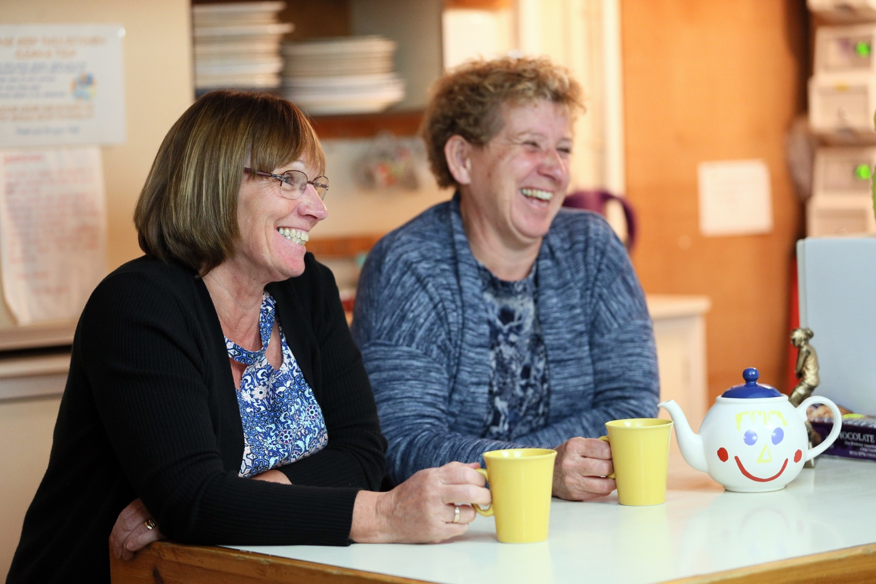
Caroline Ratcliffe,
Club Secretary
“We found electricians, tree surgeons, carpenters, solicitors and actually now ask if people would be willing to help in anyway on the membership form. They are often busy people but if everyone can just do a small amount it really makes a difference.”

Slide 31
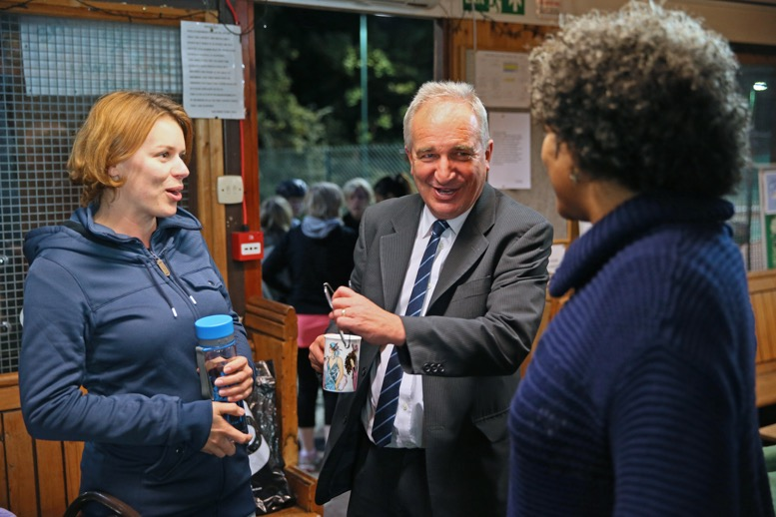
Make a personal approach
Target people face-to-face!
A personal approach always works best. The worst they can do is say no and you can just thank them for listening to you.
Ask your committee to help
Do they know any members within the club who they could ask to help?
Have a discussion about the role
Be clear on what the role requires and discuss the motivations for why they would get involved. Be open if they will need to have a DBS check.
Notes:
This advice comes through in tennis, other sports and other local volunteer organisations

Slide 32
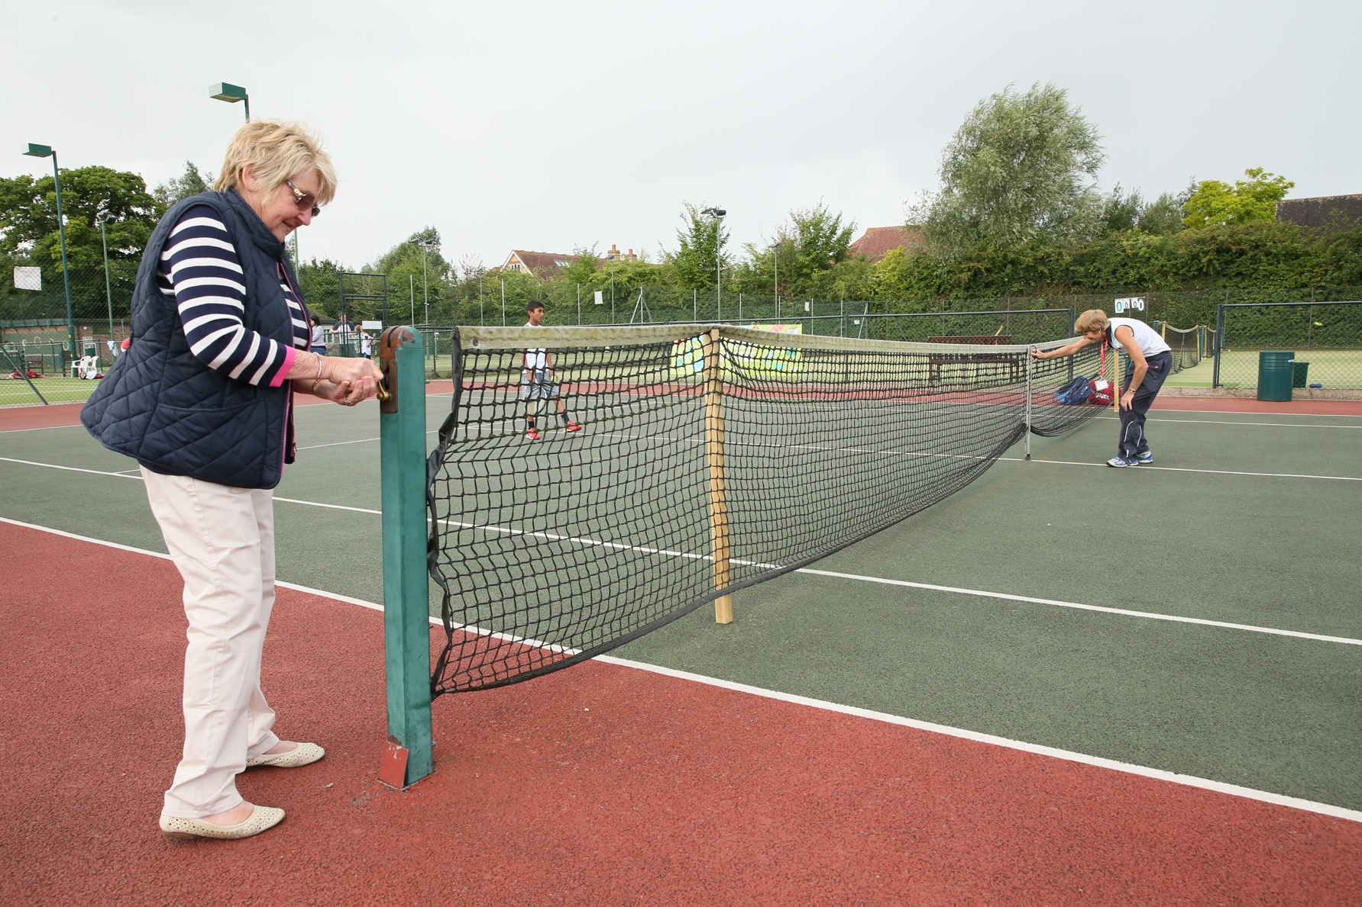
Carolyn Rothwell, Tennis Director
“If you don’t ask people you won’t get any help – people are very unlikely to offer. I’m eyeing up parents of children joining our junior coaching programme – finding out what their skills are and asking if they could do a little bit to help out.”

Slide 33

Tell them you need help
Recruitment posters are now available at ‘mytennistoolkit.com’ to advertise the roles you need. You can personalise them with your club name, volunteer co-ordinator
contact details and roles needed.
Put this up in your clubhouse, kitchen, the back of toilet doors!
Why not hand out with a welcome pack/membership forms to every parent
of a new junior member?
Advertise!
Action: Personalise posters at: www.mytennistoolkit.com
and order printed versions or print locally
Notes:
Easy way to tell people what help you need
Also being open and transparent
Why not invite members to an AGM or have an ‘open’ committee meeting

Slide 34
It’s not about doing everything.
It’s about doing something.
Notes:
This is such an important message!
Don’t scare people off with a huge role or burden
Try to divide responsibilities
Just one hour per month of help is better than nothing

Slide 35
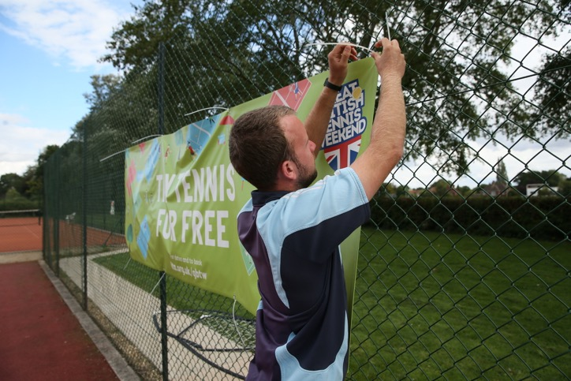
A one-off event is not as daunting
Ask your coach to speak to parents after a Mini Tennis coaching session. Could they give up an hour while their child plays at the event?
GBTW or open day event
Be clear on the role
Pair them up with a friend
What’s expected of them on the day?
Agree a time – maybe a two-hour or half-day commitment?
Meet them, brief them, thank them
Ask if they are willing to help out again
Notes:
One-off events are great for recruiting volunteers, just an hour or two is fine. Hopefully they will enjoy and be keen to do more!
Your coach has the best relationship with parents – so use them!
Take a rota along to kids’ sessions or club nights
Ask people to sign up

Slide 36

How are other clubs doing it?
“I managed to get a gang of members down to help the GBTW events including a very good junior.
“I find it’s important to actually go to members directly to ask for help – it’s their job to help the club as well. We ask people to just give an hour to help. Often they are not willing to give a whole day but just an hour is manageable.
“We went to the parents of our junior members to ask them to come down with their children to talk to other people about what their children get out of it. They were great ambassadors for the club.”
Anne Miller, Secretary

Slide 37
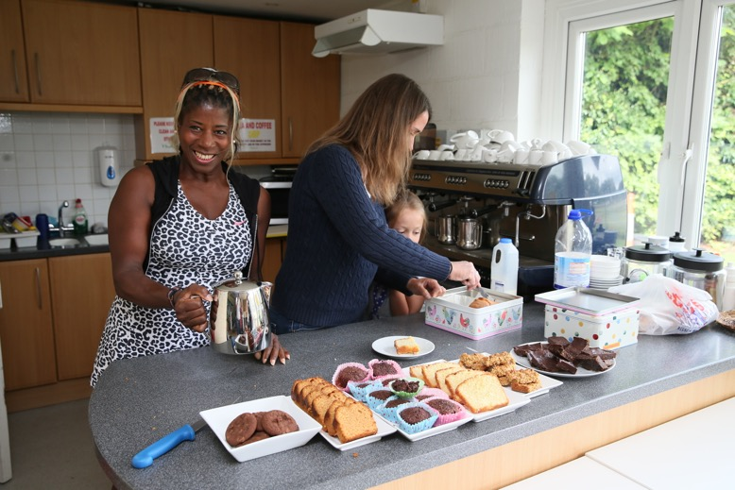
Anne’s top five tips
Give each committee member a role and tasks
Ask members to donate one hour of help
Ask existing parents to speak to newcomers
Encourage former committee members to support
Get good juniors along to help
Notes:
This works for other venues
Why not give these tips a try?

Slide 38
You have 15 minutes…
We are going to work on your venue’s plan to:
Appoint a Volunteer Co-ordinator
Have a read through the role description What skills and personality traits will you be looking for? Do you have someone on your committee who could do the role? Will you advertise? What three key tasks will you give them? If you already have a volunteer co-ordinator, what are their priorities this year?
Notes:
SESSION OPTION A
Hand out copies of the Volunteer Co-ordinator role
Circulate among different groups then you can feedback on 2-3 best ideas to move along to next section

Slide 39
You have 15 minutes…
We are going to work on your venue’s plan to:
Get volunteers for an event – GBTW, Open Day, Club Tournament etc
What do you need? Consider a rota Target members or parents or both? How do you persuade them? How will you get them to think about volunteering more regularly? Share what has worked for your venue
Notes:
SESSION OPTION B
Circulate among different groups then you can feedback on 2-3 best ideas to move along to next section

Slide 40
The four steps that can make a difference
1
2
3
4. Reach out into your local community
Notes:
Many clubs do find volunteers from outside their membership
You need to be visible!

Slide 41
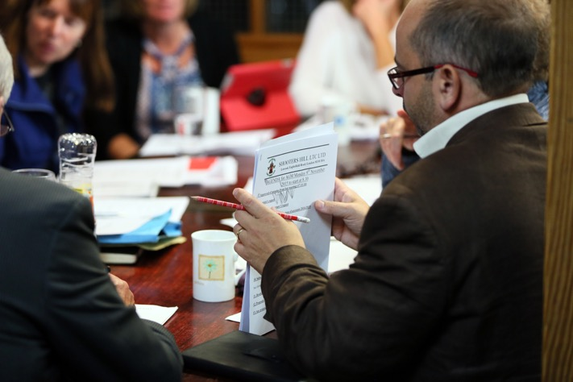
4. Reach out to your local community!
Who’s living down the road?
Retired accountants, administrators, school teachers, nurses – potential treasurers, secretaries and welfare officers!
They won’t come to you, so you need to go to them and tell them how/why/ what your venue needs help with.
Notes:
***DO NOT CHARGE NON-MEMBERS TO VOLUNTEER***
Some clubs have received enquiries via Join In website and tried to charge a £150 membership fee to allow them to volunteer!
A volunteer’s time could be worth a lot more than a membership fee
Be open, inclusive and friendly to all approaches!
Just ensure you do all recommended safety checks with new people

Slide 42
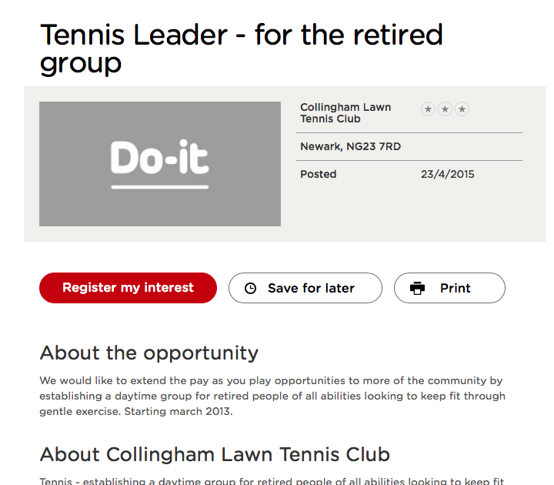
Go where the volunteers are
Action: Spend 15 minutes updating your profile at:
www.doittrust.org
Notes:
Do-it Trust
Free website to advertise for volunteers
Unsure about long-term future of Join In so would recommend using this website instead

Slide 43
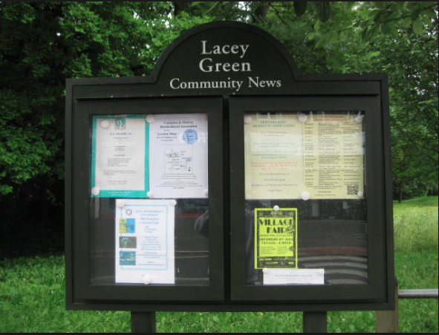
Put up posters – tell people you need help!
Remember that poster you have made?
Let’s get it up in the local community…
Community noticeboard
Local Post Office
Village Hall
Medical Centre/Doctor’s surgery
Leisure Centre
Secondary School
Higher Education College
University
Local cafés and restaurants
Church/faith centres
Local newspaper

Slide 44
Local volunteer databases
Local partnerships will have volunteer databases from major events. These people will have existing skills and interests in volunteering.
County Sports Partnerships
Volunteer Bureaus
Local Authorities
Rotary/WI
Action: Contact your local CSP and tell them what events you need volunteers for
Notes:
***Please add in contact details of you local CSP contacts in here & any additional relevant partners***

Slide 45
Young people in your community
Young people have a lot to offer and are great role models to encourage other young people to play. Consider their motivations (skills development, work experience) and also support their involvement.
Secondary Schools – Duke of Edinburgh placements.
Colleges & Universities – undertake volunteering as part of their course
Cadet forces – undertake volunteering as part of their training
Scouts/Guides
Tennis leaders – free resources for your coaches to run a course
Action: Consider which roles are suitable for young people and ask your Welfare Officer to support them.

Slide 46
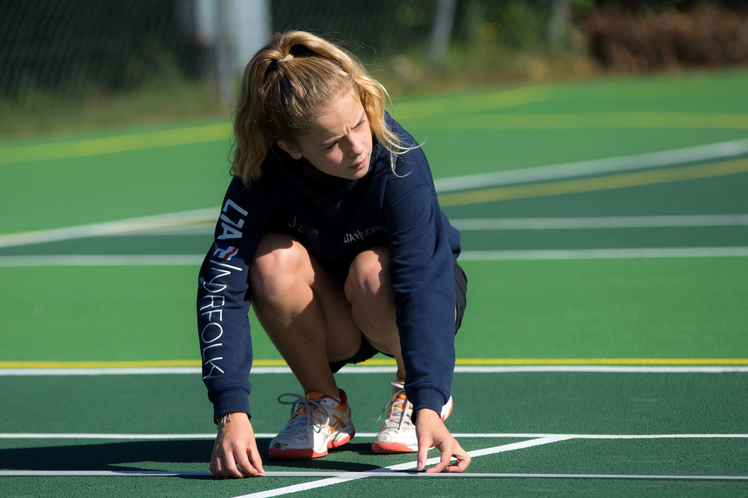
Robby Sukhedo, Community Park Manager
“We have brought through over 100 kids in volunteer
roles at our park and many have gone on to have
a job through tennis coaching, or just learning skills
for further education and other jobs. This is why we
always have a string of volunteers coming through.”

Slide 47
You have 15 minutes…
We are going to work on your venue’s plan to:
Appoint two new volunteers in 2016
What roles do you need? How will you recruit safely? Do you have a role description? Where will you find them? What skills do they need? Support / training? How will you thank them?
Notes:
Circulate among different groups then you can feedback on 2-3 best ideas to move along to next section
***Ask each club to write the club name, contact name and two new volunteer targets on a card to hand in. Collect at the end for a follow-up.****

Slide 48
Summary: what can you action?
Share this information with the rest of your committee
Appoint a volunteer co-ordinator
Understand and prioritise what help you need
Undertake a skills audit of your members
Consider how to use your GBTW/open day as a volunteer recruitment tool
Promote volunteer opportunities at your venue to your local community

Slide 49
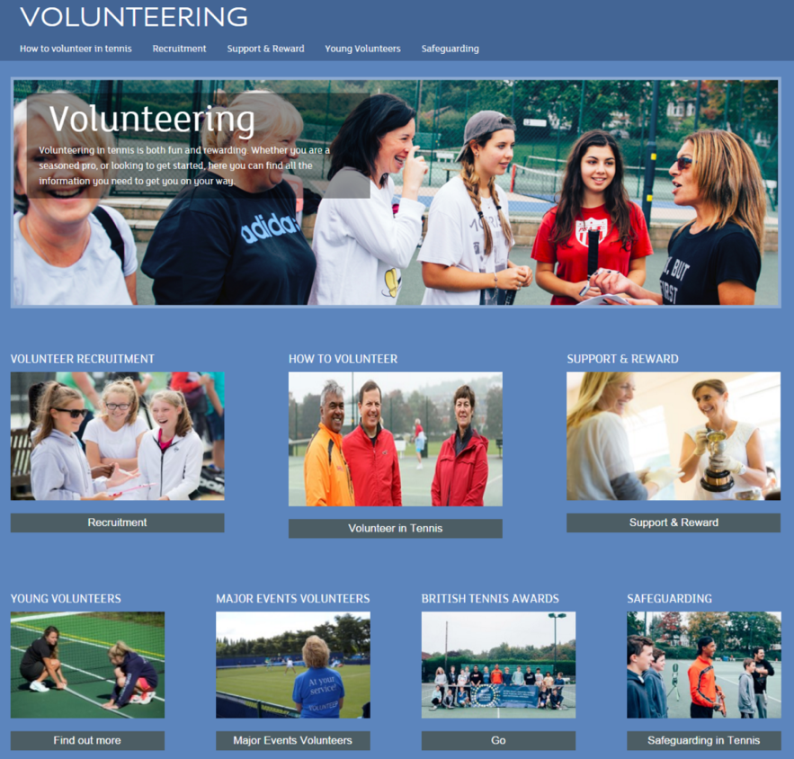
Further support: www.lta.org.uk/tennisvolunteer
Notes:
Go online to download free resources and see more advice
**ANY SUGGESTIONS FOR ADDITIONAL CONTENT OR TEMPLATES WELCOME**

Slide 50
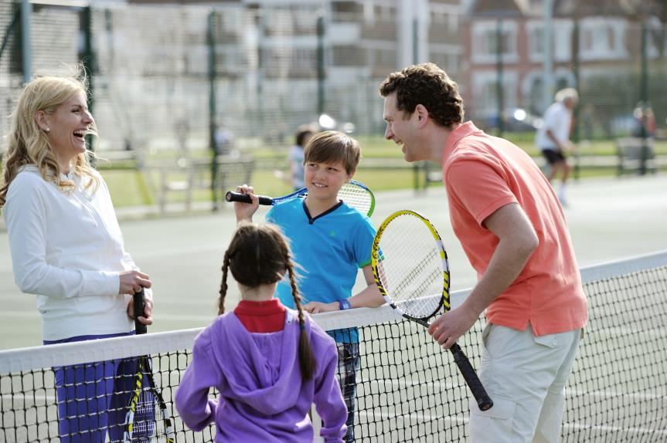
Growing & Retaining Membership & Participation Venue Forums – Spring 2016
Notes:
Introduce yourself
To build up your credibility
Add any experience you have in working in clubs in your introduction
Explain we have a central team working in this area and our findings are based on continuous Regional surveys into player behaviors and feedback given by clubs in recent surveys

Slide 51
What we hope to achieve
Outline the principles that are known to grow and retain participation
Look at local examples and share good practice
An opportunity for you to take what you have found useful back to your club
Notes:
Explain that we recognise that people attending this evening will be in different places of understanding and experience in implementing ways to attract and retain members.
The purpose of the session will be to ensure everyone has a basic understanding of the principles that we know will grow participation
There will be the opportunity to look at and work on some examples, learn from some of the things you might be doing already and share some of the good examples that you have implemented and have been successful.
At the end of the session we hope you will have a better understanding of the customer journey new members at your club might take and how you might now put some ideas into practice

Slide 52
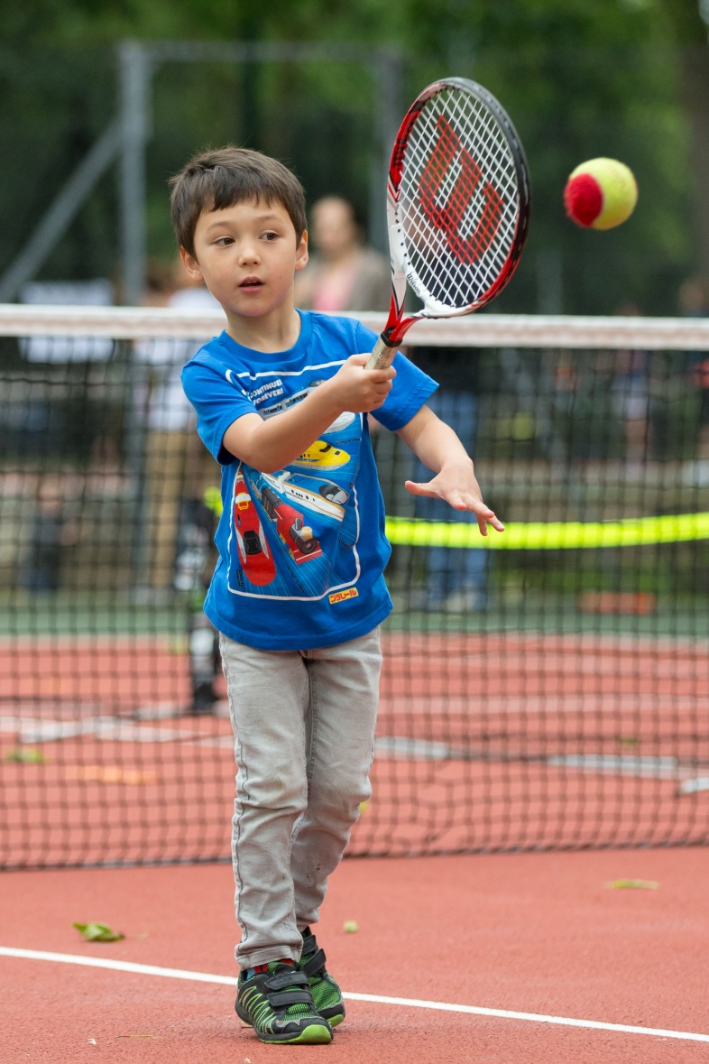
Growing & Retaining Participation & Membership
        In the LTAs Venue Survey in 2015
        “the biggest challenge clubs say they face is attracting new members & retaining current members”.
Notes:
In the LTAs Venue Survey in 2015 the biggest challenge clubs say they face is attracting new members & retaining current members.
Increasing participation requires effort, hardwork & collective buy-in from all within a club. There is rarely an easy quick-win solution, but requires a structured realistic plan that existing club members / club officers support – new members won’t stay long if the rest of the club don’t make them feel welcome!
Often growing participation requires the club to be flexible, innovative and prepared to try new things to meet the needs of new/different/wider audiences. It is important that you understand that audience!
We will also give you the opportunity to discuss approaches with other similar sized clubs within the room to try & help bring this to life and share success and best practice

Slide 53

Principles of Growing & Retaining
        4 key elements to consider
Quality of Environment
Understanding your Audience
Marketing & Communication
Suitable Product / Offer
Notes:
If you wish to have a successful participation campaign, clubs of all sizes need to consider and address all 4 of these elements – Quality of environment, understanding your audience, Marketing and communication and suitable products. The next couple of slides will briefly examine these.

Slide 54
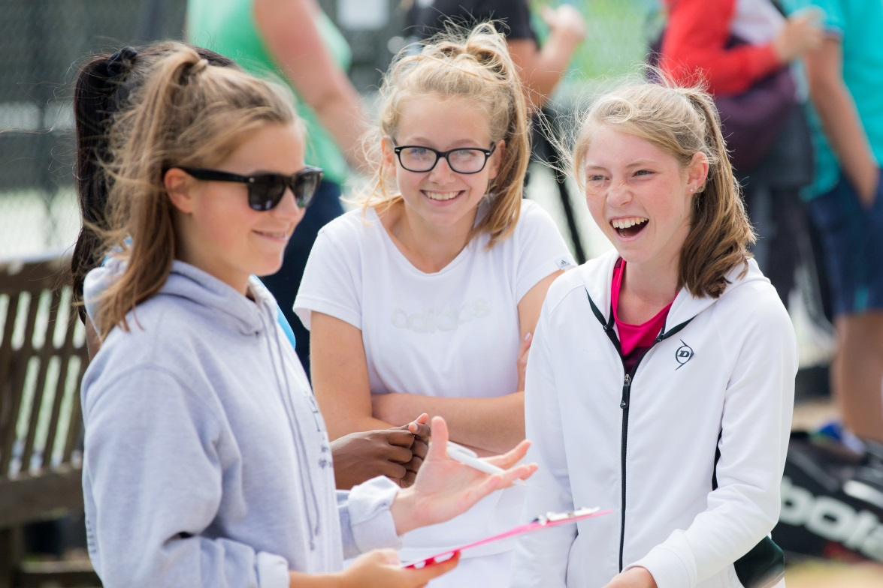
Principles of Growing & Retaining
        It is important to recognise that different groups of members will be seeking different things from their club membership!
        Traditional club members
        Transactional members
Notes:
It is Important to recognise that some members/target audience will be seeking to be actively involved in club-life & that is part of what they are signing up for; but equally important to realise (particularly in modern society) that others will view their membership in ‘transactional terms’ – I pay my membership fee and in return I expect a quality of service. The ‘transactional’ members will view the tennis club similar to other membership’s (e.g. gym & other leisure subscriptions) & if it does not meet their expectations then they will cease their membership. In most cases they will not be prepared to play an active role in club-life.
Expectations will differ greatly depending on the mindset of the member & what they want from their membership. Clubs genuinely looking to grow their participation need to embrace both types of members – those that see it as a lifestyle choice – others as a service.

Slide 55
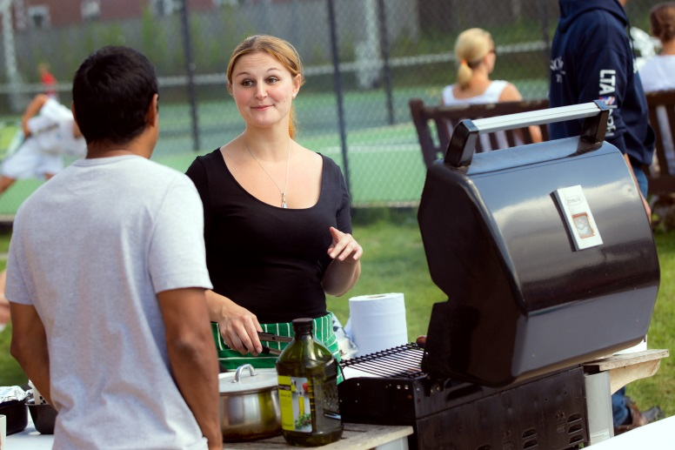
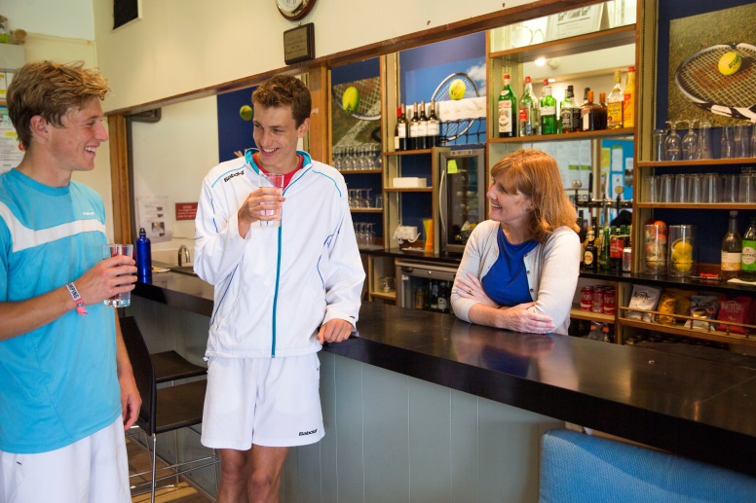
Principles of Growing & Retaining
        1. Quality of Environment:
          Facilities
          Playing, coaching & competitions
          Social activities & atmosphere
          Personal communication to members
          Appropriate membership packages
          Accessibility of the facilities at the time the member needs them
Notes:
Consideration of the club environment is crucial prior to launching a new participation recruitment campaign – especially when it is focused on a particular target audience. There is little point investing time and resource into a campaign if the quality of the club environment does not meet the expectation levels of the new participants as the club will struggle to retain these participants in the long term. So the quality of environment is a key element of any participation drive.
When considering the environment its not just about the Facilities. There are clubs with outstanding facilities that struggle to attract / retain participants because the wider environment surrounding the club is not of a high enough quality. Whilst there are clubs with poorer quality facilities that have an excellent club environment that have excellent membership retention.
Key areas you need to keep challenging and reviewing
Have you got the right balance of Playing, coaching & competition programmes as part of your offer
The right Social aspect & activities of the club (inc. club culture & atmosphere)
The Quality of communication from the club (as a member do you make them feel valued?)
Appropriate membership packages (do you provide perception of value for money)
Accessibility of the facilities at the time the member needs them
........these are just some examples – but other factors will depend on the expectations of your members.

Slide 56
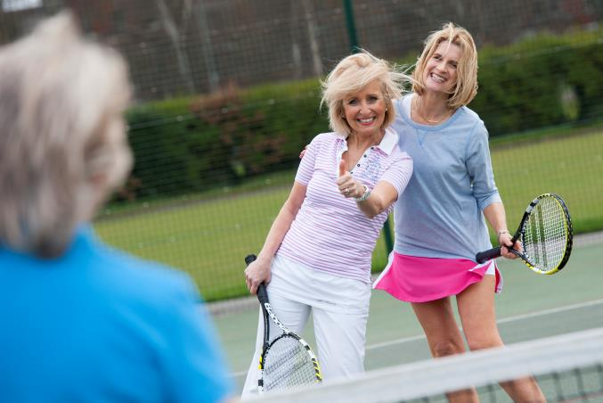
Principles of Growing & Retaining
        2. Suitable Product / Offer:
        Who are you trying to attract?
        What are their motivations & interests ?
        Is it tempting & appealing?
        How can you reach &
        communicate with this audience?
        Can you meet the expectations you promised?
        Can you keep them afterwards?
Notes:
Establishing new offers / schemes is an important step in helping to retain members – so not just useful for recruitment.
The more precise you can make the target audience, based on proper insight and accurate information, the more relevant and focused you can make the offer so that it appeals directly to that audience and increase the likelihood that a greater percentage will come to the club.
Use the market segmentation tool provided by Sport England to help you understand the profile of people who live around you
Think of the follow-on offer or how the club can tempt the participant to remain following the initial engagement – this is the crucial stage that is often neglected. Talk to the participants - don’t just leave it to chance that they will take the onus on themselves to approach the club about remaining / joining as a member. How do you keep it fresh. What are the right methods of communication that your target audience use.

Slide 57
Principles of Growing & Retaining
        3. Marketing & Communication:
        When delivering projects aimed at growing participation consider:
          The audience
          Consider the customer journey
          What is the ‘call to action’ for someone that see’s your marketing materials.
          The suitability & relevance of the marketing materials
          What networks / partnerships / communication channels can you access
        Effective communication in helping to retain participants is maybe less familiar.
          How do you make your members feel part of a warm & welcoming club?
          How do you create a positive atmosphere where all feel connected to the club?
Notes:
Marketing and Communication This is important for both retaining your current members & attracting new ones.
Try to put yourself in the shoes of your target audience and understand what messaging, style of communication, methods of communication that they best respond to. What is the most effective way of reaching this audience. What is relevant - (e.g. putting flyers in the library is perhaps not the best place to reach 18 – 30 yr old women for Tennis Tuesdays; instead flyers in the local Starbucks might be better….etc). Do not just rely on putting info on the club website or in the club-house – you are not reaching new audiences here.
What is the call to action – make sure you have one
Do not instantly think of posters and flyers as the only way to promote; and similarly do not just rely on social and digital media; in most cases there is a place for both. If you are using hard copy materials think clearly about where you are going to use them to reach your target audience & the quantities needed. If you are using social media, think about where you are directing potential participants to find out more info about your club; but you need to maximise the reach of your social media promotions through trying to encourage as many people as possible from your networks to ‘like’ or ‘retweet’ – and do not rely on promoting on social media just once….the messaging needs to be relatively regular over a period of time (without bombarding people). Try and create some fun / exciting messaging that helps capture the attention.
When people see your promotion ensure it is easy for them to find-out more (e.g include your club website on posters etc) & ensure when they reach your website it is clear how to find out about your promotion. Regarding the participant journey – think about where they go to find more info, if they have more queries is there a clear contact, is it clear what the offer is (e.g. do they need to sign up for 6 wks, can they turn up whenever they want etc), do they need to book in advance, who do they speak to on arrival, do they need their own equipment etc etc….
Utilise & actively encourage your existing club members to spread the word through their friends, family & work groups (this is often the most effective way of gaining new participants); if you have a club sponsor consider if they are willing to help communicate through their channels; consider approaching nearby businesses; if you have strong relationships with local agencies (local authorities, educational facilities, NHS, local sports related bodies etc); particularly promote through previously lapsed club members.
It is often easy to think of marketing & communication as only important in growing the membership & neglect this with their current members. It is a useful component in helping to build a quality club that helps to retain participants. Through a varied communication style you can help set the tone and atmosphere within the club and help members to feel connected and ‘bought in’ to the club. You obviously have the traditional club newsletters – but try to make these as exciting and interesting as possible, providing info that will be of interest across the whole membership spectrum – whilst making it personal to the members, don’t always focus on the same few members all the time – ensure mentions and references are split evenly through the club membership (through the different teams, age groups, social groups and even casual participants); make sure there are high quality images and that it’s presented professionally. Ensure your website is up-to-date carrying interesting info; consider establishing a social media presence to engage with your members; ensure material in the clubhouse is up-to-date and reflects the image the club is trying to project; social and club activities is an important element of internal communication – try to ensure all are invited, welcome and encourage diverse groups from within the membership to come along .

Slide 58
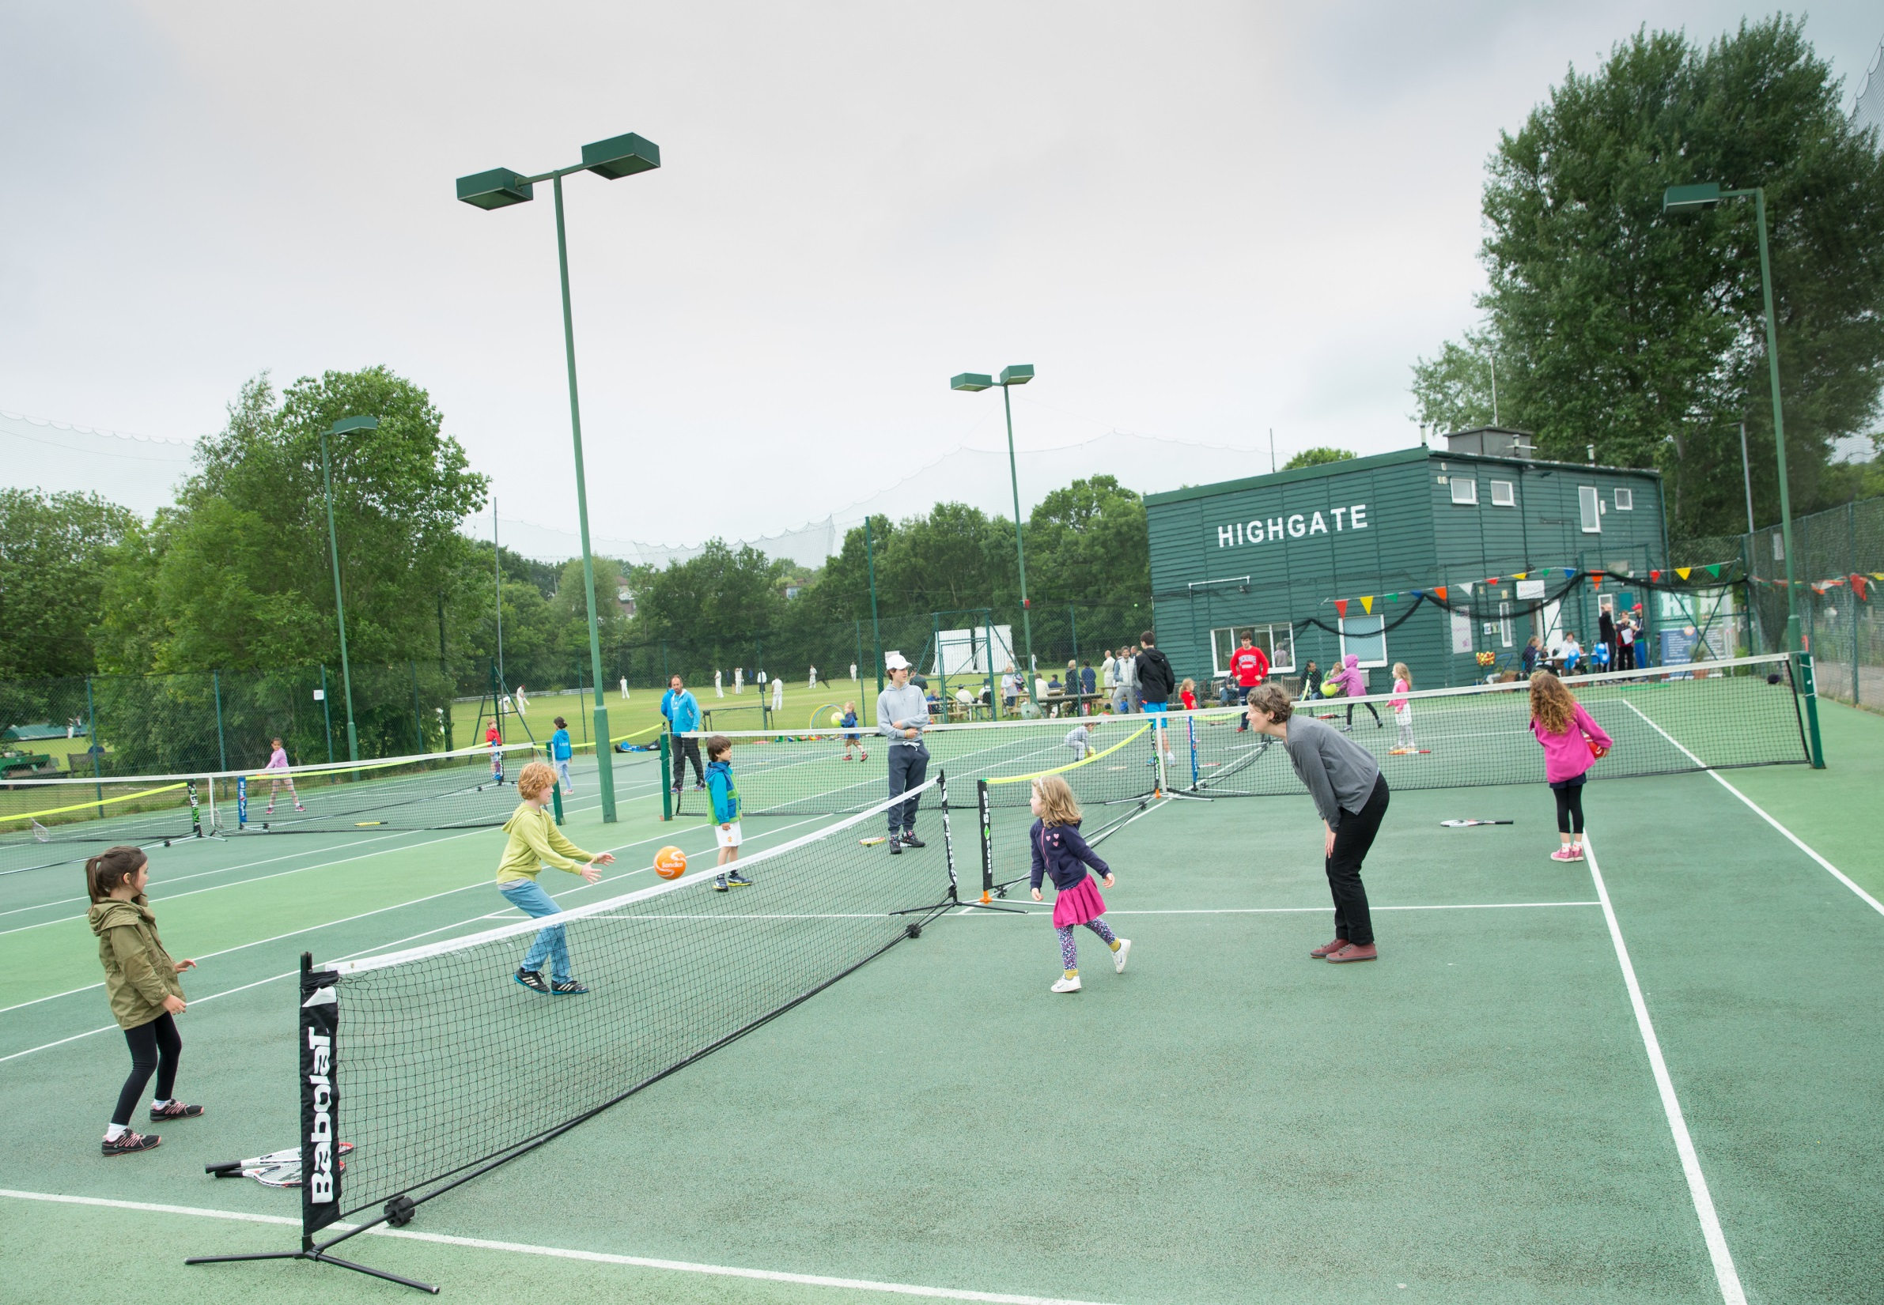
Group Discussion
In groups discuss the situation that the club in the scenario that you are given faces.
What steps would you recommend the club should take?
Consider:
1) Quality of Environment
2) Suitable Product / Offer
3) Marketing & Communication
Notes:
This is all about helping you think about your approach and hopefully learning from others – giving you practical tips to take back to your clubs
Need 3 case studies
Split them into small groups and provide each group with a real-life case study from the region (suggest no more than 2 or 3 case studies to speed up the feedback process – more than one group can review the same case study)
Provide the groups with a handout that provides a brief snap-shot of the challenge or position that the club finds themselves in (don’t provide the real club’s name at this stage); e.g.:
A club that over previous years has had a massive drop-out of members
A club that is significantly under-capacity
A club that does not have a particular demographic within it’s membership (e.g. shortage of juniors / teenagers / young adults / females etc)
The groups are given 5mins to discuss
Feedback: Each group (or groups if more than one group is looking at each particular scenario) provides a quick summary of their discussions. The presenter then provides an outline of the steps the actual real-life club took to remedy the situation and the results, paying particular reference to the 3 themes discussed in this presentation (aim for no more than 5mins per scenario to feedback)
Ideally structure the groups of representatives from similar sized clubs.

Slide 59
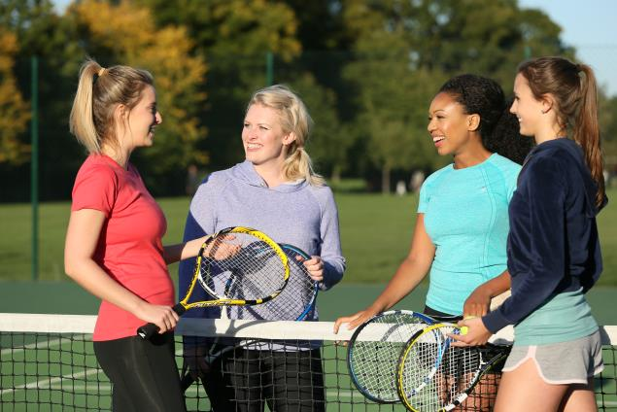
Understanding Your Audience
        We will break this information into the following broad segments:
          Juniors (U16s)
          Adults 21 – 40 yrs old
          Young Families
Notes:
The LTA conducts research into the trends & behaviours within the British population to better understand the challenges & motivations for different ages and segments of society in playing tennis.
We will provide a quick overview of some of this information to help you when developing your club plans in targeting specific audiences.
This info is only a guide to overlay with your current knowledge & to help get you thinking along the lines of the specific target group.
The 3 broad segments have been selected as this is frequently whom clubs say they want to target, we also know that there is the potential to grow participation within these categories.
You might have existing types of members – but you will need to go over and beyond the current offer to change what you are doing
Need to consider the impact also of attracting more of a type of segment
Would encourage the presenter not to use LTA terminology such as titans, troopers, spinners etc as this will confuse & detract from the detail.

Slide 60
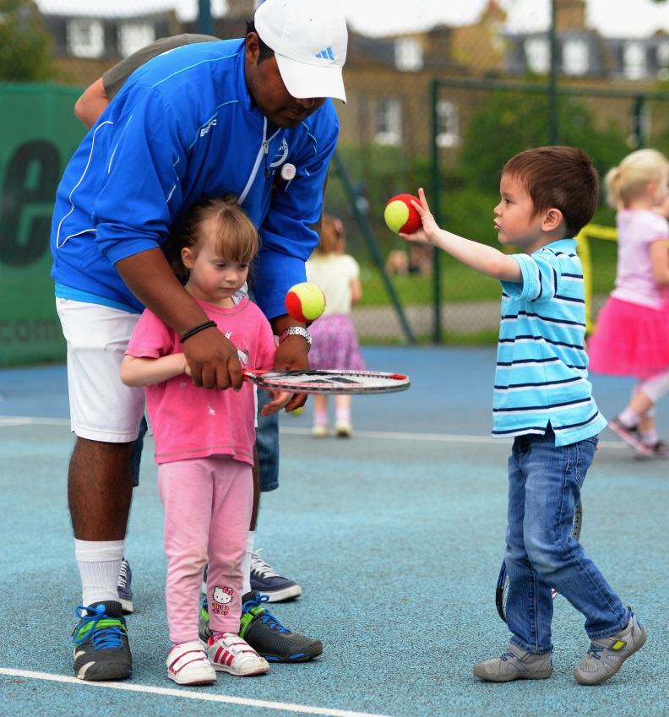
Juniors – Who are they?
        Juniors
        Majority play in schools or parks
        Led by parents
        Play lots of sports
        Want fun
        Teenagers want to be
        Choosing their favourite sport
        Spontaneous
        Make their own decisions
        Want variety & prefer to do things in social groups.
        They want to play sport on their terms
        2/3 communicate through smart phones
Notes:
Vast majority of children play in schools &/or parks with 15% playing in clubs
parents at the younger ages instigate activities for their children and want to provide their children with a variety of sporting & leisure opportunities to see which one their child enjoys most (so will often bounce from one sport to another). It is important when they experience tennis – they have a the best experience possible and its fun
Between 9 and 12 children will be settling on the sports they enjoy the most but secondary school represents an important landmark for children:
More homework
Greater independence from parents
Greater sensitivity to their own abilities (winning v losing) & perception amongst peers
Teenagers want to be
Spontaneous
Make their own decisions
Want variety & prefer to do things in social groups.
They want to play sport on their terms
Teenagers: 2/3rds of children have a smartphone by 13yrs old; communication is primarily through social media in small interactive bite-size chunks – hard to retain attention for long periods.

Slide 61
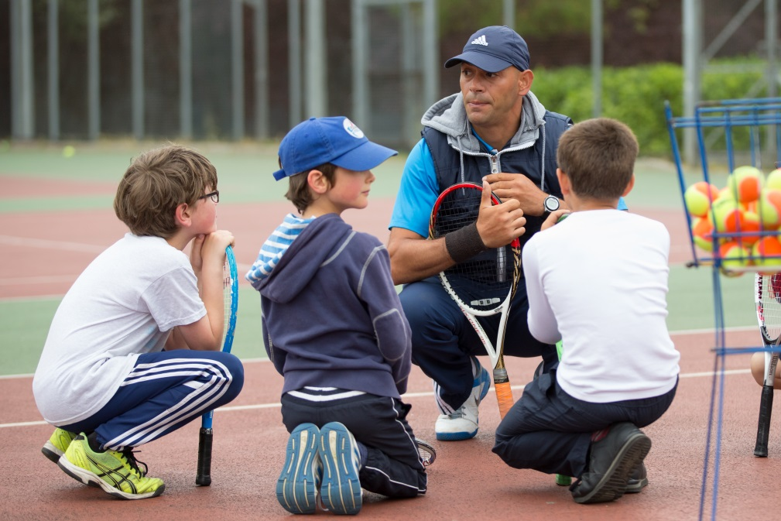
Juniors
        Reach into community to maintain relationships
        Consider the parent when organising
        and planning
        Involve social aspects to creating teenage offer – eg Junior/Teenage club nights
Notes:
Due to the transient attitude that children take to sport Clubs need to develop a way of reaching out into the community through an outreach program
Potentially be prepared for parents to decide to move their younger children into different leisure activities after a period of time; so think about ways you can remain in communication with offers / promotions etc as there is a good chance that they may return.
Consider how this impacts on the parent when planning LTA programmes / comps:
Eg Mini Tennis Programming – consider the role of parents & children during the different age groups of the programme & particularly how the sessions are delivered (younger age group is parent-led; older age group will see children increasingly having a voice in decisions & being more aware of their peers). Consider the importance of the coach. Eg Consider through the different levels of mini-tennis – the times need to fit in with parent as much as the player. Keep the ability for children to move up on the same evening. How & who does the club market this to and ongoing communications with the parents & children once they are involved.
Consider Junior Club Nights – good opportunity to encourage social interaction around tennis activity for teenagers. Ensure the club discusses with teenagers to understand best day and the format of it (perhaps even try & develop partial ownership of the Jnr nights by the teenagers). Encourage variety and team play. Are teenagers made to feel welcome by the rest of the club – or as a burden on taking up courts that the adults could be using? Are there other off-court activities / provision that the club could be offering on Jnr Club Nights to increase teenager satisfaction? How & who does the club market & promote this activity? Who is the best person to lead these evenings from the club’s perspective?
Aegon Team Tennis – supports the desire from teenagers and older children for more team/social based elements in tennis.

Slide 62
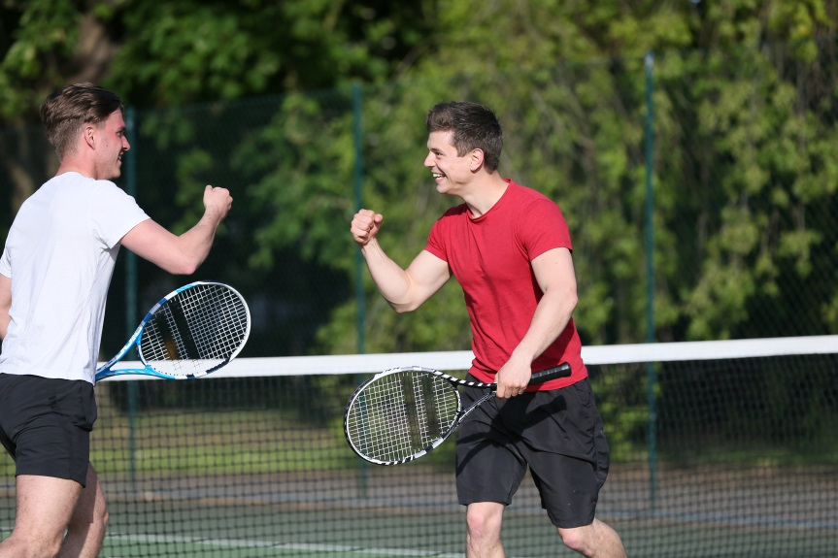

Adults (21 – 40yrs old)
        LTA research indicates that there is significant interest in this age group to play more tennis if the ‘offer’ was right.
        They need their leisure activities to fit around them, otherwise they will choose an alternative
        This age group often see parks as more attractive
        They have challenging perceptions about clubs – not good enough, for serious people, stuffy
        Seasonality is crucial
Notes:
Nationally there are significantly less adults playing in this age range compared to the 40yrs+ age groups. This is the age range that many clubs are most concerned with as they find it difficult to increase their memberships with participants in this age bracket.
LTAs national participation research in 2015 indicate that there is approx 900k women & 950k men aged 21 – 40yrs who would like to play more tennis. This is a significant opportunity - But the suitability of the offer is paramount – needs to fit into their busy lives, be at the right cost, in the right environment / location, with the right-minded people, at the right standard etc etc…
The majority of these adults are in the ABC1 category (e.g. middle class professionals) ABC1 groups at this age in general have time constraints and lead busy professional lives, often with young families. They need their leisure activities to fit around them, otherwise they will simply choose an alternative leisure activity that does.
For this demographic, there is often a desire to merge their sporting activities with a chance to socialise and see their friends (i.e. due to their ltd time, they don’t get a chance to see mates, but if they can do this whilst also keeping fit then that is an added benefit).
LTA research indicates that adults who did not play as a junior in most cases do not start playing tennis as an adult. Subsequently, it is difficult for someone to persuade their friendship group to start playing – this can be a barrier for people starting to play again.
This age group can often view parks as more attractive to play their tennis than clubs due to opt wanting to play tennis all year round
They may have perceptions that you have to be a good player & clubs are only for serious tennis people
They may just play occasionally and thinking about playing more so going to a annually Subscription fees could likely be considered too much to pay out
They may have the Perception that clubs are traditional & stuffy (“not for people like me….”)
Seasonality is also crucial – this target audience in general want to play tennis in the spring & summer, but are less interested in playing in the winter. They are frequently involved in other sporting activities & often play these at other times in the year.

Slide 63
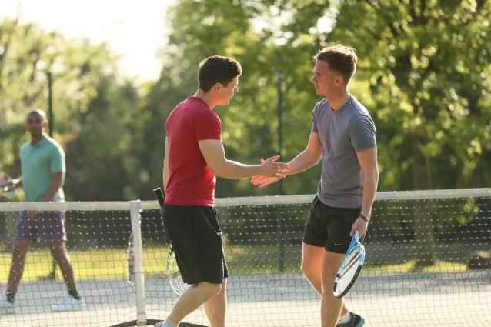
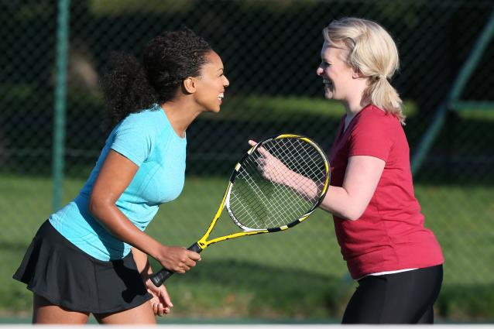
Adults (21 – 40yrs old)
        Be flexible in terms of your offers
        Make players feel welcome
        Short term offers
        Consider external communications which promote the club as a vibrant place
        Simply offering what the club always offers in many cases won’t be enough.
Notes:
There are opportunities for clubs to increase their participation with adults in this age range if they are able to develop suitable tennis opportunities that meet the needs of this target group. You will need to consider
Being flexible in terms of your membership packages & programming for this age group.
Making new players feel welcome within the club & have the appropriate playing opportunities at times that suit them.
In many cases players may only want a loose commitment to the club – not necessarily looking to become a life-long member.
Consider the club’s external communications to promote the club as a vibrant place that resounds with this age group.
However, simply offering what the club always offers in many cases won’t be enough.
Eg Can Fast4 (an new fast competition format) be a beneficial and fun format for this age group who want to compete but have not got the time to play league matches due to time limitations?

Slide 64
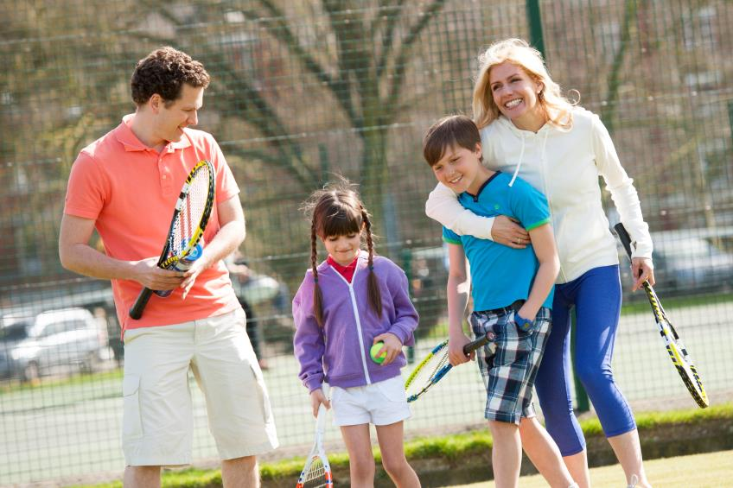
Families
        There are few sports that both children and parents can play together
        Children of parents who play tennis are more likely to remain playing tennis through childhood
        Parents factor family time into weekends
        Cost is an important consideration
Notes:
There are few sports that both children and their parents can play together or at the same time – tennis has a unique opportunity to attract both
Our research indicates that those children whose parents play tennis are far more likely to remain playing in tennis throughout their childhood.
Busy lifestyles mean that parents tend to factor a portion of the weekend for dedicated ‘family time’ – there is a great opportunity for tennis to be the weekly ‘family time’ slot but again Spring and Summer are the key months that they want to play tennis
Cost is a consideration, particularly as the parents will frequently have a range of other leisure activities that they will be paying for their children to undertake.
Think about how GBTW and Quorn Family Cup:
GBTW – open days to attract families into the club in the first place. What activities do you run during the open day to appeal to families & generate positive satisfaction; what offers do you put on to encourage the families to sign up / return
Quorn Family Tennis Cup – opportunity to provide stimulus to help retain those families currently playing at the club & to keep them positively engaged in playing on a regular basis.

Slide 65
Group Task
In small groups look at your example and focus on either improving membership retention or growing participation for the target audience and have a go at developing a plan of action.
Don’t forget to think about the 4 key principles:
Quality of Environment
Understanding your Audience
Marketing & Communication
Suitable Product / Offer
Notes:
Ideally structure the groups of similar sized clubs. Should be 3 – 4 people in each group.
Help facilitate the discussions in each group & encourage them to focus on what has been presented / discussed
You could provide a small action plan template for them to complete
No need to feedback to the rest of the group – best to allow them maximum time to discuss this in their small group.
How might you retain more adults within your club – consider the product/offer
How might you attract more families to play and then continue to play at your clubs
How might you retain teenagers -

Slide 66

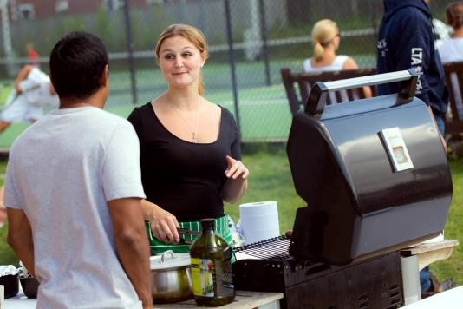
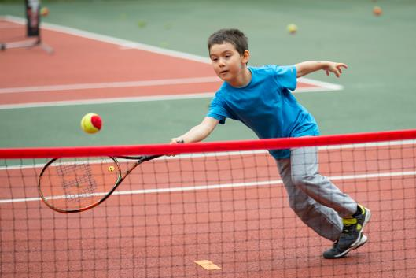
Summary
        Consider the four key participation principles:
          Understanding your Audience
          Quality of Environment
          Suitable Product / Offer
          Marketing & Communications
        Retaining participants is far easier than attracting new ones. But growth is possible as long as the club is prepared to be innovative & try new approaches: doing what you have always done is not likely to be successful.
Notes:
It can be difficult to generate new members, but you can give your club a better chance of being successful if you consider the four key participation principles:
The 4 principles also play a key role in helping to retain your existing members. Consider if your club understands your members tennis needs & if the club is meeting them?

Slide 67
What can you action tomorrow?
Look at your current club membership and what you want to achieve
Look at the specific target audience(s) you want to attract.
Create an offer
Review its success

Slide 68
Summary of Call to Actions this Summer…
Spring 2016
Notes:
Ask for any questions – we will need a statement should any questions come up RE BTM

Slide 69

Somerset LTA
AEGON BRITISH TENNIS AWARDS
Club of the Year | Queen Camel Tennis Club
Disability Tennis Programme | Steve Shortland
Coach of the Year | Dan Sizer
Volunteer of the Year | Richard Powell
APRIL 2016 | Regional panels meet to select regional winners

Slide 70
Somerset LTA
New Projects in the County
Frome
Chard
Wellington
Opportunities for Funding
Marketing support for GBTW
Sponsorship changes
Davis Cup Legacy Update
Davis Cup Tour Update

